Slide 1
I will be ABLE TO UNDERSTAND the digestive system

Slide 2
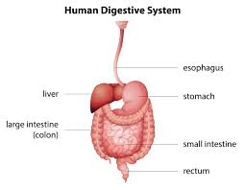
Digestive system
A system of organs that absorbs water and nutrient's from food while removing waste.

Slide 3
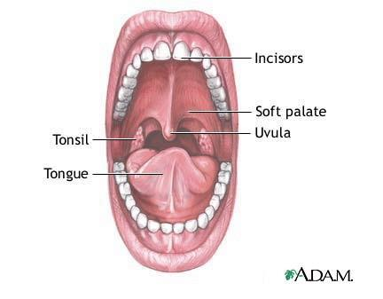
Digestion starts
Digestion starts in the mouth. You teeth cause a physical change and your saliva causes a chemical break down.

Slide 4
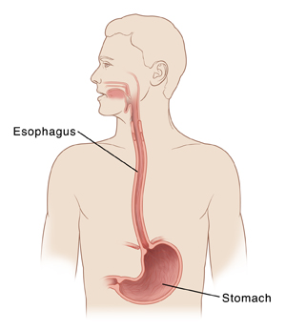
Esophagus
The esophagus is the long tube that moves food from your mouth to your stomach.
The stomach mashes food into a liquid. The juices in the stomach break down nutrients and kill germs.

Slide 5
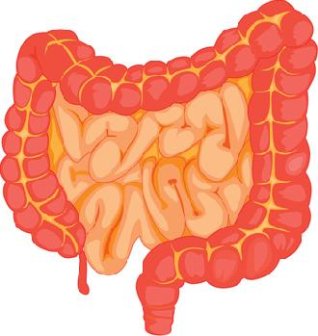
intestine
The small intestine is a tube that absorbs nutrients.
Large intestine- absorbs water and minerals.

Slide 6
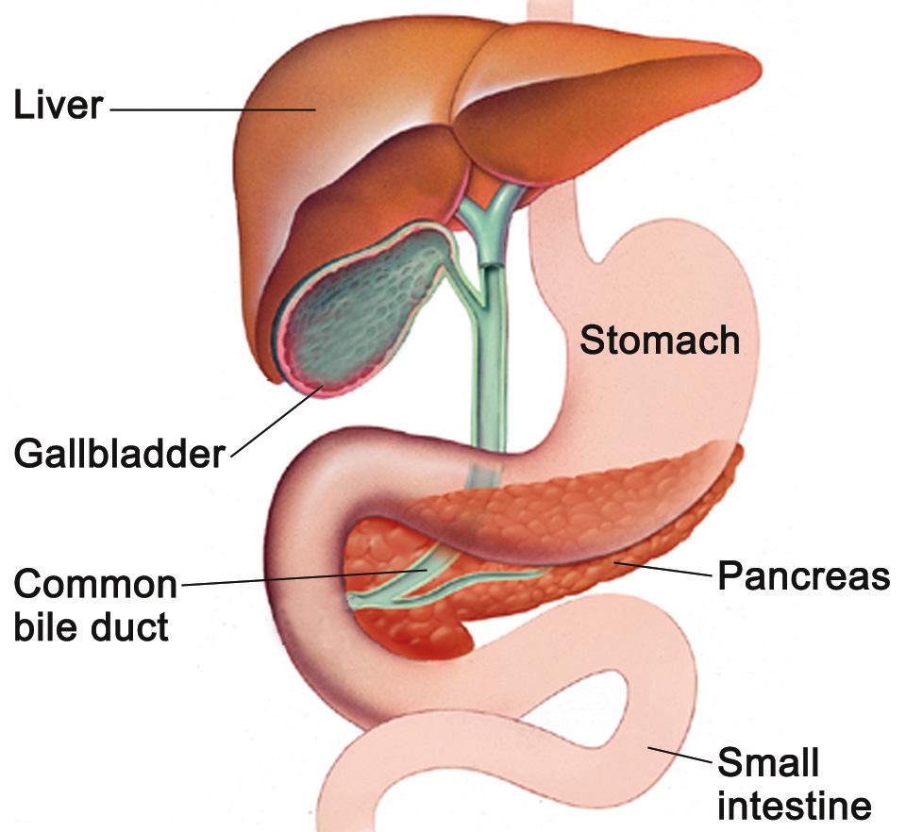
Other digestive organs
Liver- makes juices called bile. This helps to break down fat.
Gallbladder- store the bile from the liver.
Pancreas- makes juices for the small intestine to break down fat and proteins.

Slide 7
I will be ABLE TO UNDERSTAND the Urinary system

Slide 8
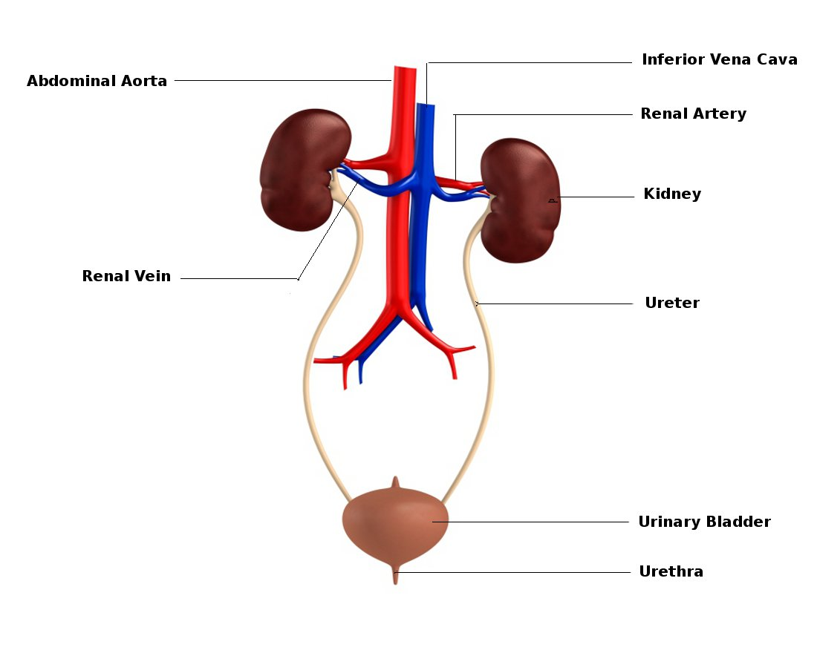
Function
After we burn off energy there is waste left behind our body needs to get rid of.
After we use protein ammonia is made, which is toxic.
Ammonia is made into urea and get out of the body as urine.

Slide 9
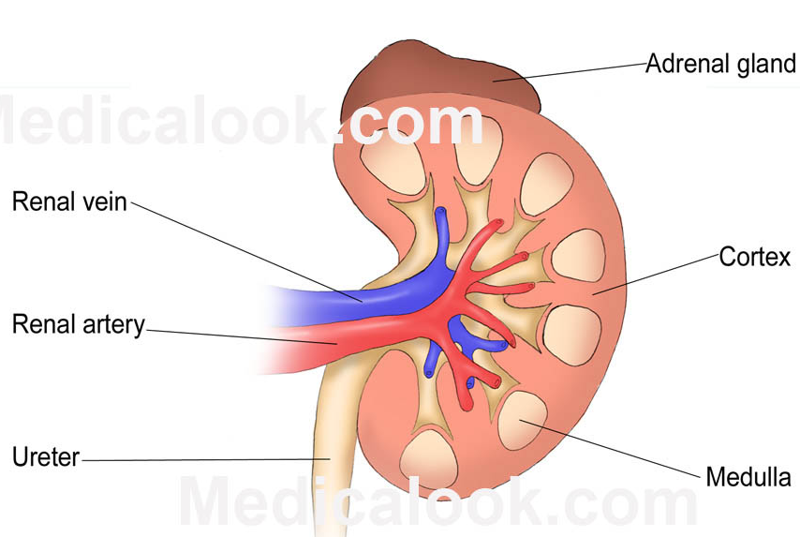
The kidneys filters the blood.
They also conserve water and balance salt levels.

Slide 10
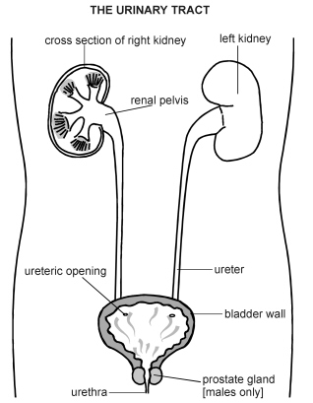
Ureters-are the tubes that take the urine from the kidneys to the bladder.
Bladder- stores the urine
Urethra- take the urine from the bladder to outside the body.

