Slide 1
I will be ABLE TO UNDERSTAND THE Nervous SYSTEM AND OUR SENSES

Slide 2
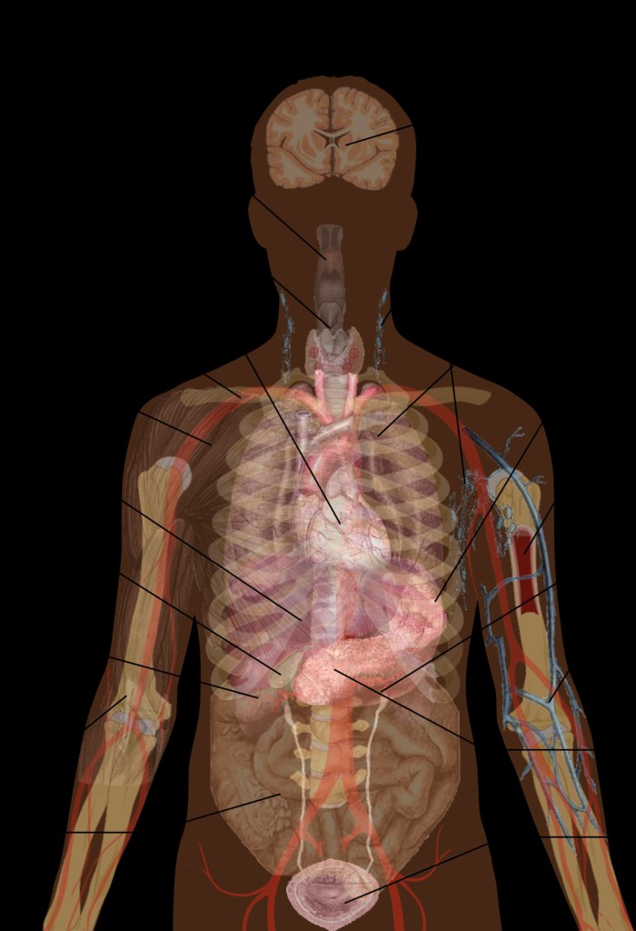
Body Parts
Organism- a living thing
Organ- a body part that is made up of smaller parts that work together.
Organ system- a group of organs that work together for one job.

Slide 3
Plants have organs too
Stem helps a plant stand just like our bones do.
Barks protect a plant just like our skin.
Leaves help plants eat just like our mouths and stomach.
Leaves keep water in just like our skin.

Slide 4
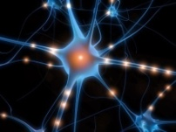

Sensory Organs Exploration
Just below the outer layer of the skin we have sense organs that respond to pressure, pain, and temperature. There are two types of temperature receptors:
Hot receptors respond to things hotter than our skin.
Cold receptors respond to things colder than our skin.
They are clustered together in hot spots and cold spots.
While a thermometer can tell us the exact temperature of something. We can only compare the temperature of our skin.
Notes:
Engage: Ask what are our sensory organs? ( eyes, nose, ears…..) Have students read the first paragraph. What do sensory organs in the skin respond to?
Explore: Say we’re going to do an investigation to look at how the sense organs located in our skin respond to temperature.

Slide 5
Sensory Organs
stimulus- a change inside or outside the body. Special cells in the nervous system called neurons carry messages to and from the brain and spinal cord.
Sensory neurons detect a stimulus.
Notes:
What are the sensory organs? (eyes, nose, ears, receptors in our skin tissue)
What is the function of our sensory organs?
What is reaction time?
What does the brain do? Students can make the Brain at Work foldable to read for more information.

Slide 6
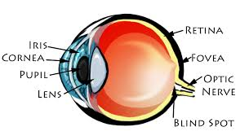
Eyes
Iris- the part that is in color.
Pupil- passes light into the eye.
Retina- senses light and sends the information to the brain.
Lens- helps focus vision
Cornea- protects your eye

Slide 7
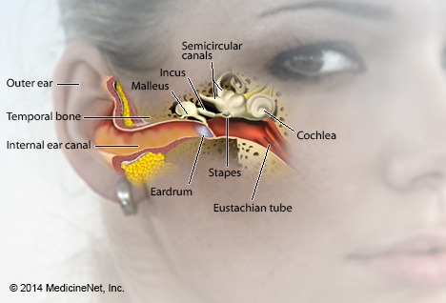
Ears
Eardrum- the part of the ear that vibrates when we hear sounds.
Cochlea- filled with liquid and transfers vibration to little hairs that are attached to neurons.

Slide 8
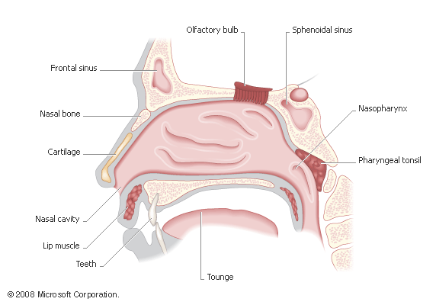
Nose
Olfactory bulb- detects chemicals carried in the air.

Slide 9
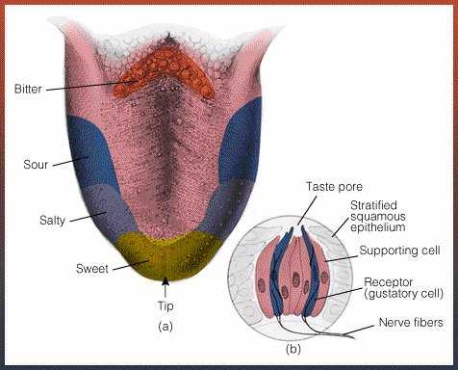
Tongue
Taste buds- sense chemicals in food.

Slide 10
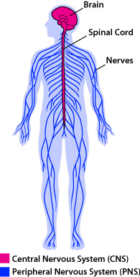
Nervous system
A system that helps us sense our surroundings and allows us to move voluntary and involuntary using nerves.

Slide 11
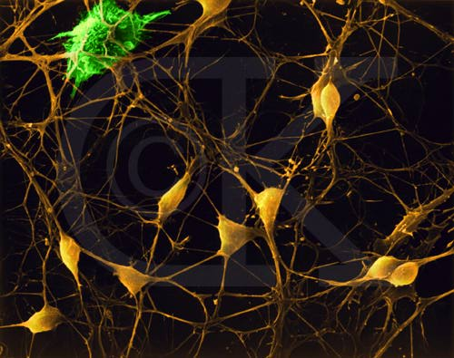
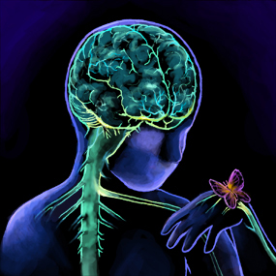
Nerve cells- sense stimuli.
Nerves- a chain of nerve cells that carry information to the brain.
Spinal cord- a bundle of nerves that carry information to and from the brain to all parts of your body.
Brain- processes information and controls body functions.

Slide 12
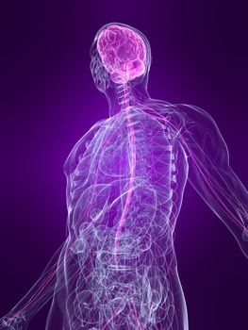
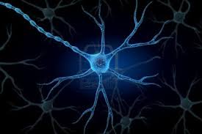
The Nervous System Continued.
The neurons in the nerves system sense the stimuli and send it to spinal cord then the brain where it decides that to do.
This happens in fractions of a second.
Your nerves feel touch before you can react (Ouch).

Slide 13
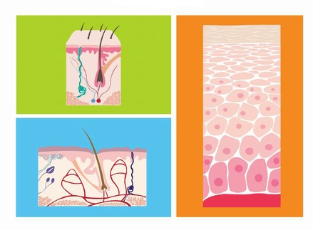
What does our Skin/integumentary system do for us?
Protects your other organs and tissues.
Helps maintain a stable body temperature.
Water and wastes leave your skin in perspirations.
Structures such as hair and sensory organs are contained in the skin.
What’s special about the skin when
compared to all other organs?
It’s the largest organ in your body.
Notes:
Explain: Say: Let’s watch the video to find out about our skin. Click on the hyperlink Skin in the title. What are its functions? What’s special about our skin compared to other organs? (it’s the largest)

Slide 14
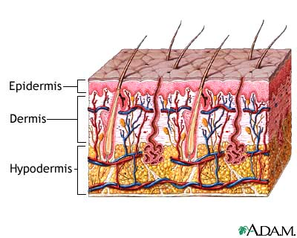

Slide 15
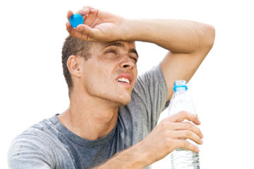
Why we sweat
Wen you sweat, it evaporates which means it takes heat away from you.

Slide 16
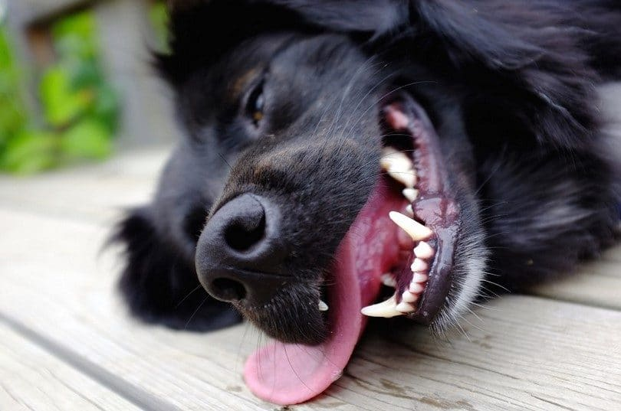
Dogs don’t sweat
Dogs do not sweat, they get rid of heat by panting.
Why does it take longer for tem to cool down.
- Your skin has more surface area than a dog’s tounge.

