Slide 1
Water!
I will be able to identify the different climate zones.

Slide 2
Weather vs. climate
Weather is what the atmosphere is at one point in time.
Climate is how the weather is over a long period of time.

Slide 3
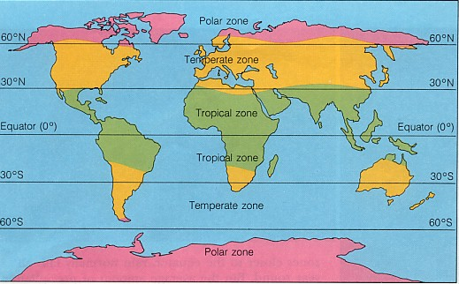
Climate
Climate is the long-term weather PATTERN.
Climate zone- an area that has similar average temperatures and precipitation throughout.

Slide 4
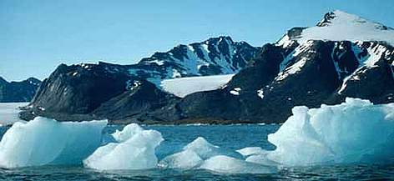
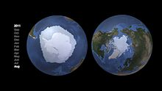
Polar Zone
Covered in ice and snow year round. The sun is never high in the sky. Temperature is 10 degrees C or below.

Slide 5
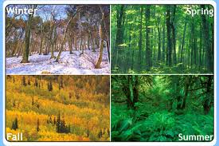
Temperate Zone
Moderate temperatures and different types of precipitation. It has all the seasons.

Slide 6
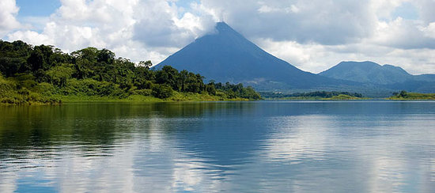
Tropical zone
Near the equator. The sun is high in the sky all year.

Slide 7
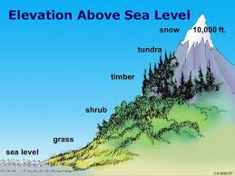
Elevation
Elevation- height above a given level, especially sea level.

Slide 8
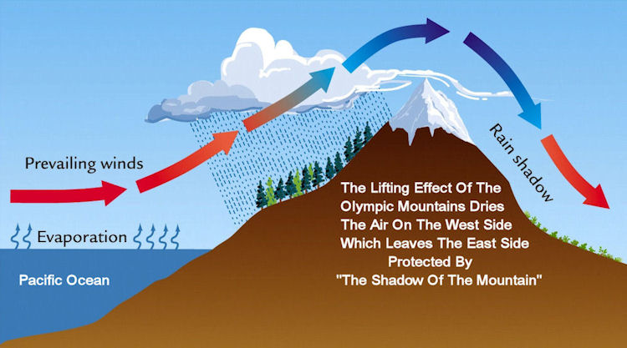
Mountains can affect rain patterns.

Slide 9
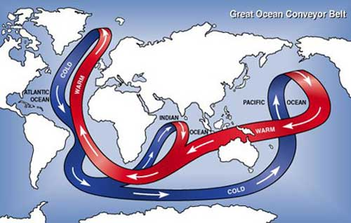
Ocean current affect Weather.

Slide 10
Biomes
Biomes are regions of the world with similar climate (weather, temperature) animals and plants.
5 major types of biomes: aquatic, desert, forest, grassland, and tundra. Others split biomes further.
https://www.youtube.com/watch?v=hIy0ZlyPPDg

