Slide 1
I will be able to identify different types of galaxies.

Slide 2
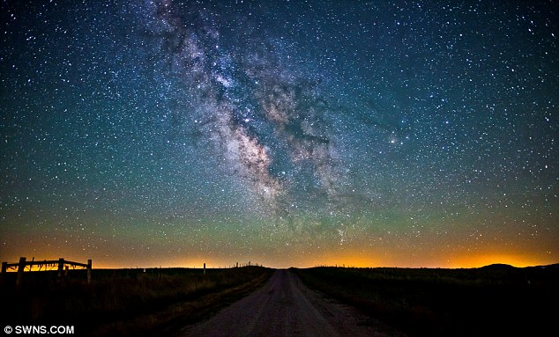
Astronomy- the study of objects in space.
Stars- huge balls of hot, glowing gases that produce heat and light.
If the sun is a small star why is it that it looks so big compared to other stars in our universe?

Slide 3
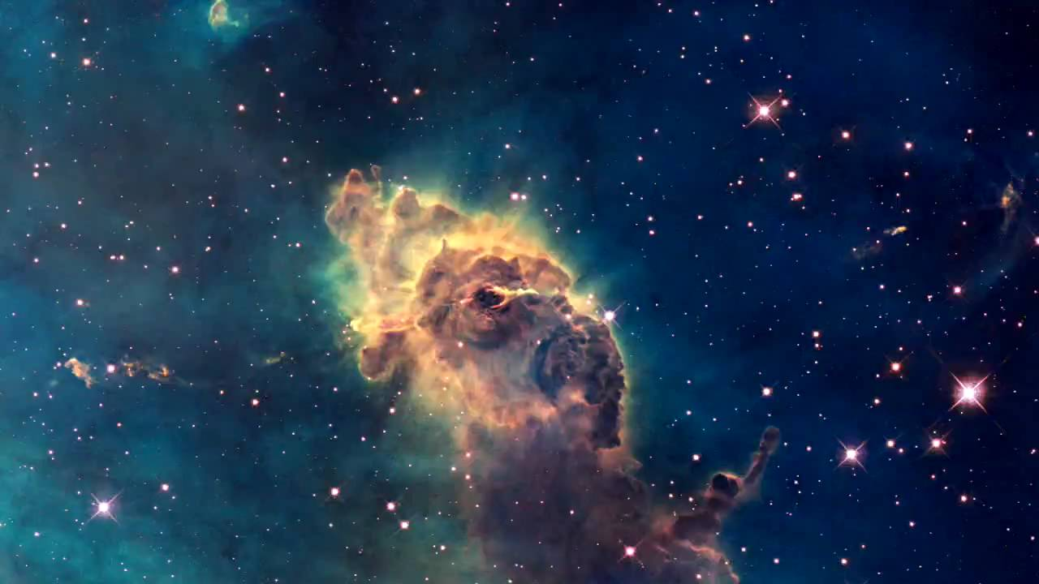
A star is born when gravity causes gas and dust to pull together (squeeeezed REALLY tightly) until heat and light is released.

Slide 4
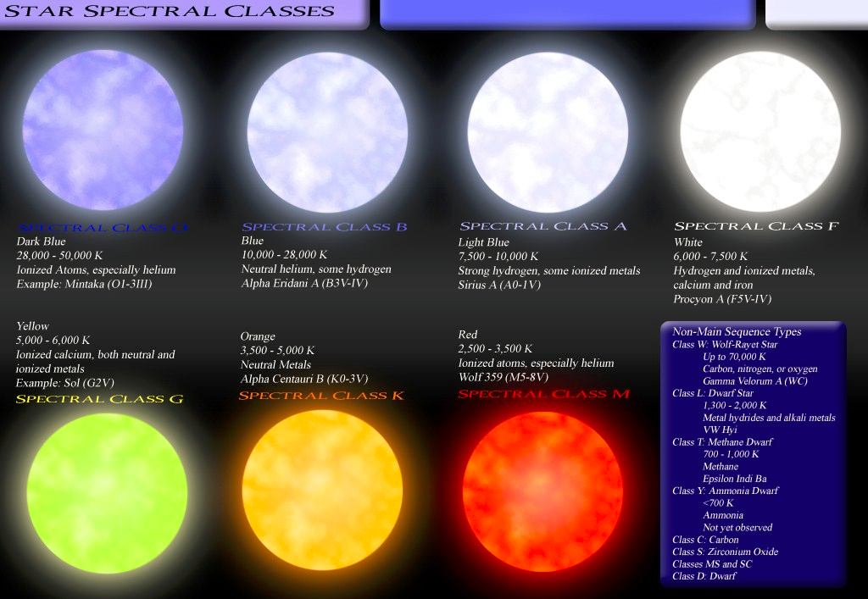

Slide 5
Constellations
a group of stars forming a recognizable pattern that is traditionally named.
Larger stars are usually brighter because they are closer.
https://www.google.com/sky/

Slide 6
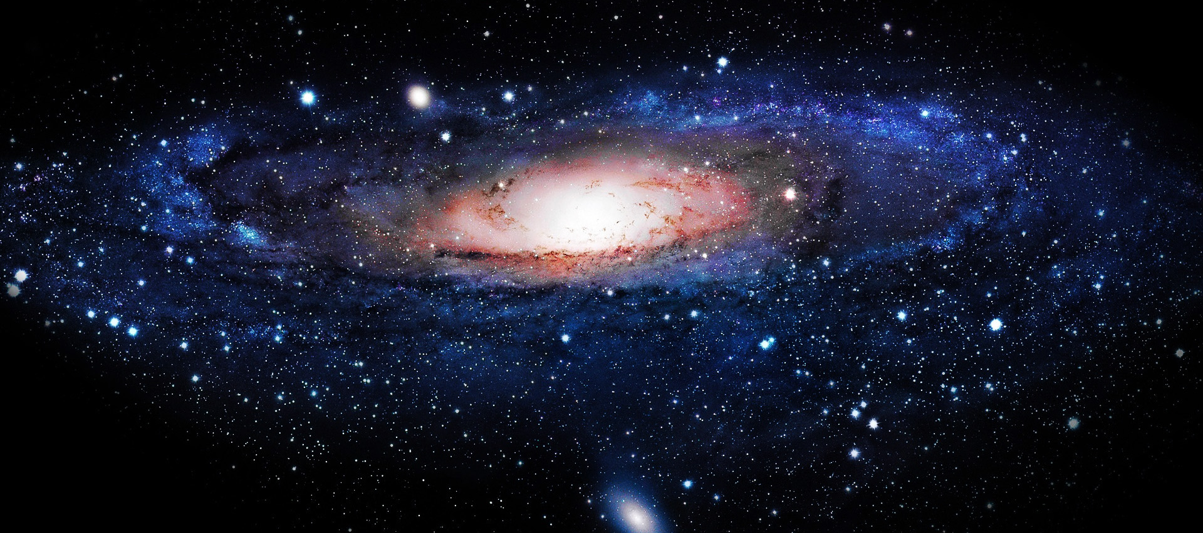
Galaxy- a group of billions of mostly stars and other objects that orbit stars that is held together by gravity.
We live in the milky way galaxy- a spiral galaxy.

Slide 7
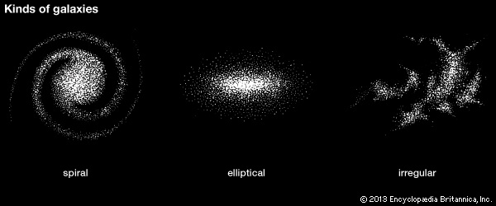
Shapes!
Spiral galaxy- pinwheels or barrel shaped.
Irregular galaxy- randomly scattered.
Elliptical galaxy- sphere shaped (football).
http://www.discovery.com/tv-shows/other-shows/videos/how-the-universe-works-family-of-galaxies/

