Slide 1
Objective: I will be able to identify the objects in the solar system.

Slide 2
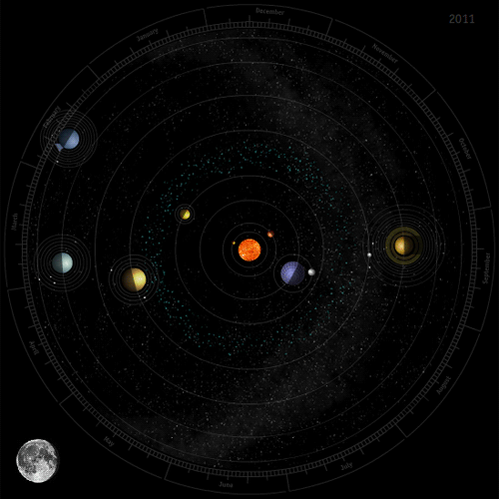
Solar system
A solar system is made up of a star and the planets and other space objects that revolve around it.

Slide 3
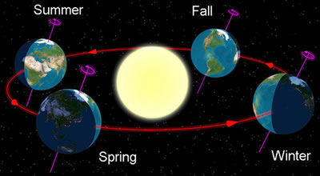
Revolution- the movement of one object around a center or another object.
Rotate-to move in a circular or curving course or orbit.

Slide 4
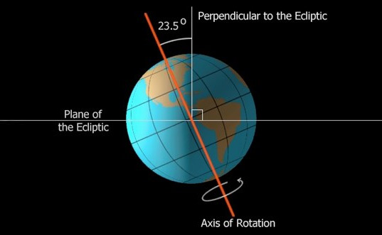
Axis- the imaginary line that goes through the center of the planet.
The earth tilt is what causes seasons.

Slide 5
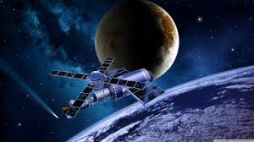
Satellite- a celestial body orbiting the earth or another planet

Slide 6
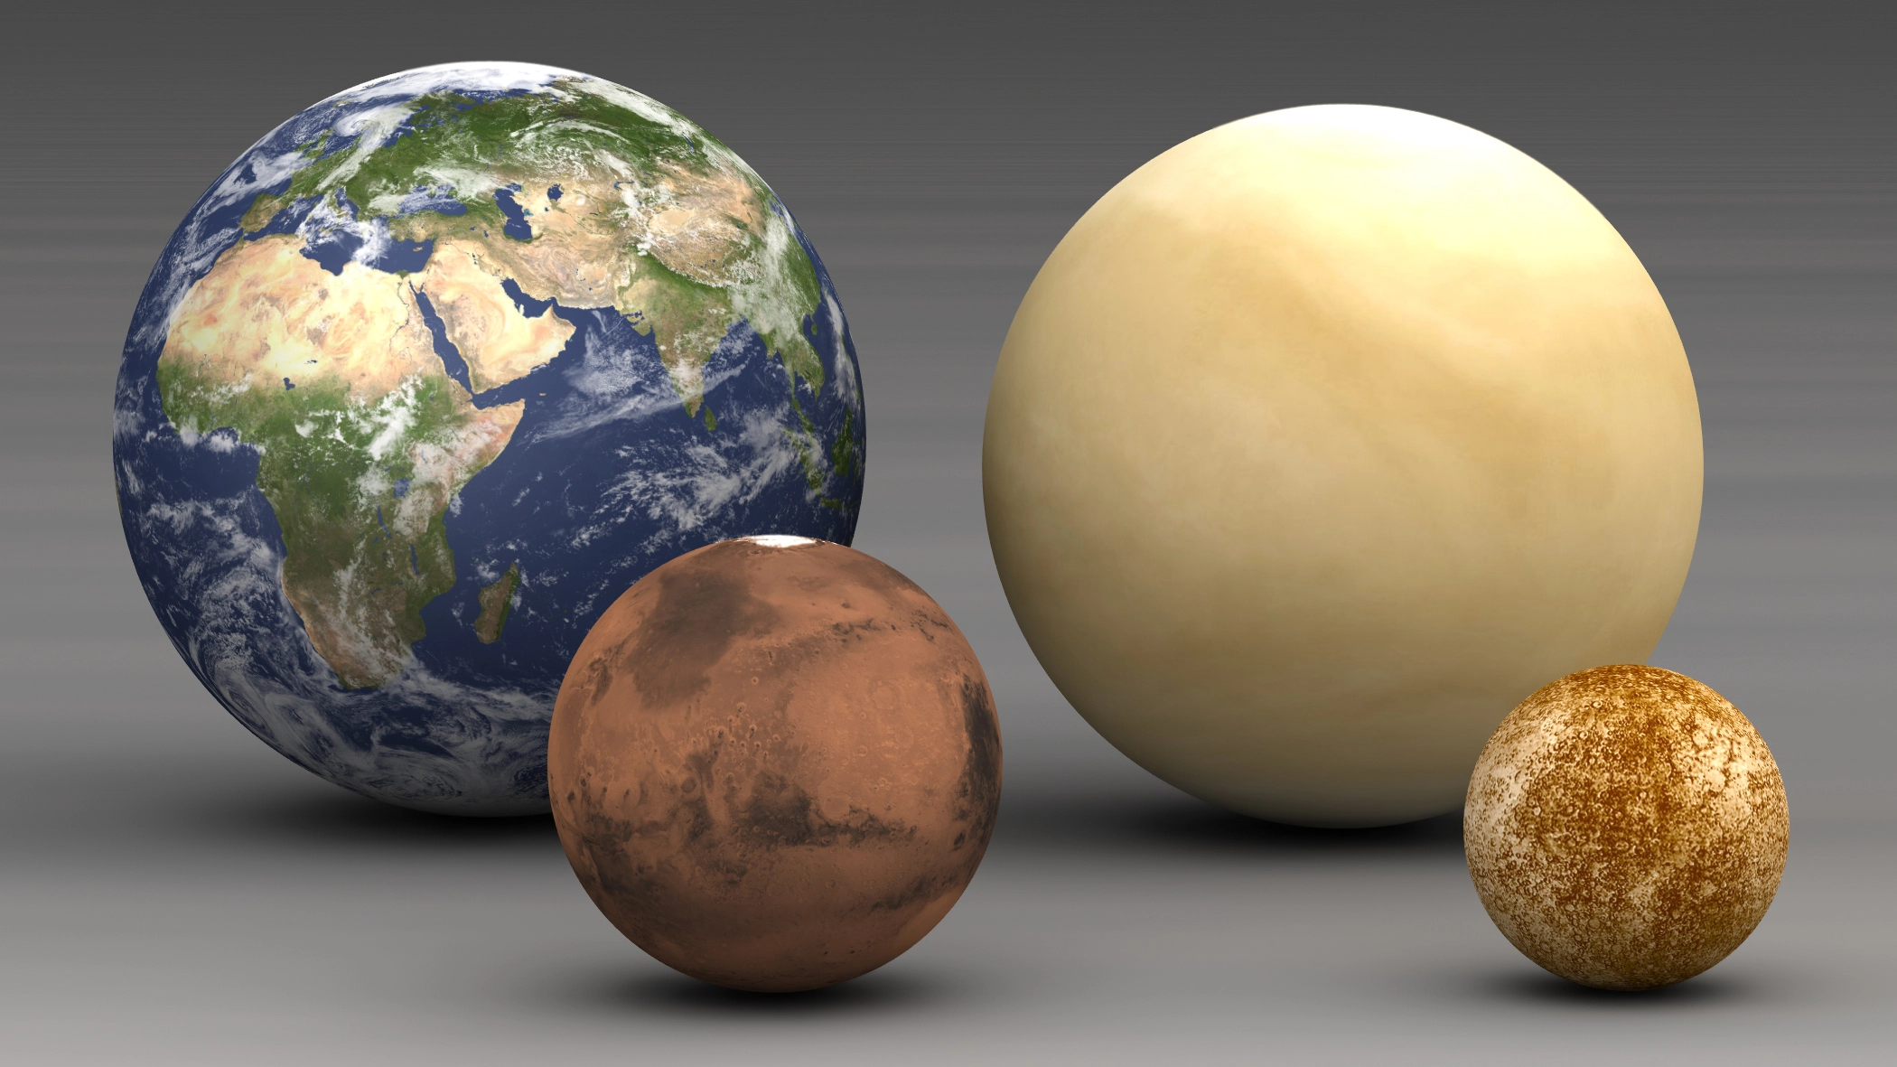
Inner Planets
The inner planets are Mercury, Venus, Earth, and Mars.
Inner planets have rocky surfaces and solid cores. They are the smaller group in our solar system. They also have thin atmospheres.

Slide 7
Videos

Slide 8
Objective: I will be able to identify the differences between the outer planets

Slide 9
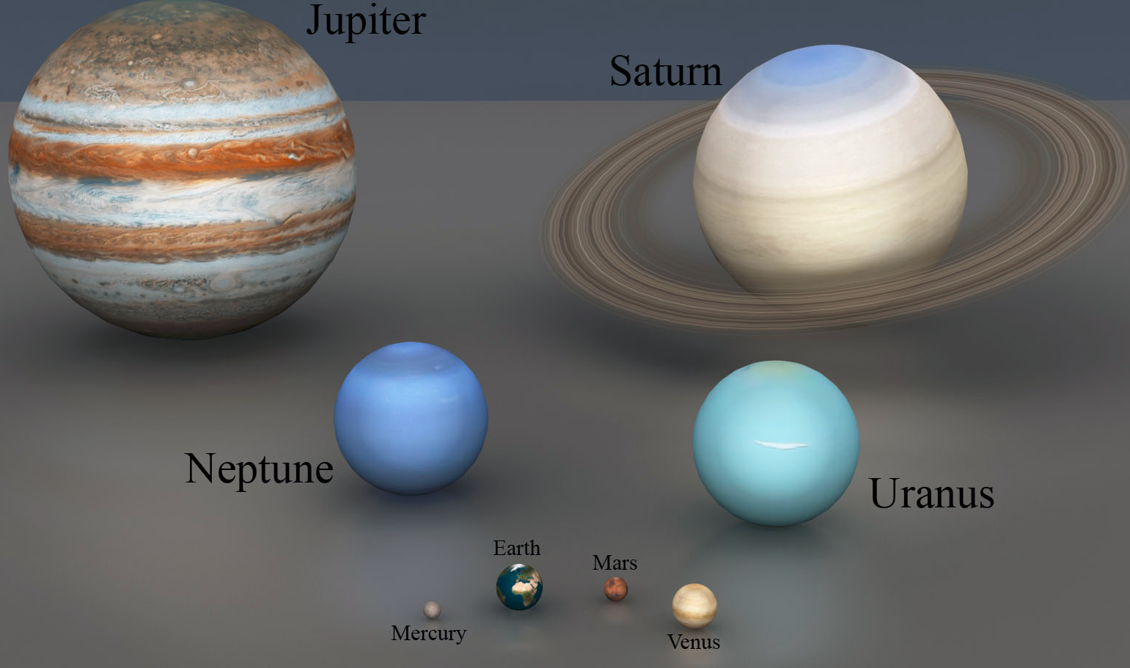
Outer Planets
Outer planets are farthest from the sun.
They are called gas giants.
Do not have a solid surface.
They have small cores.
They have many moons and most have rings.

Slide 10
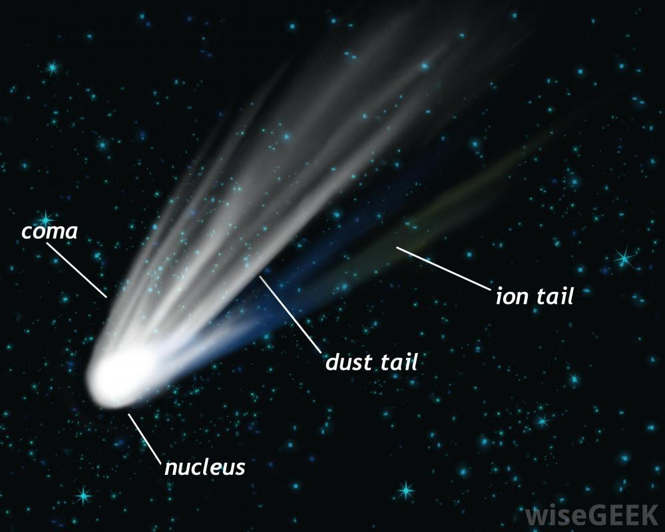
Flying Objects
Dwarf planets- a spherical celestial body revolving about the sun, similar to a planet but not large enough to gravitationally clear its orbital region of most or all other celestial bodies.
Asteroid- made of rock and iron.
Comet- frozen gas, rock, ice, and dust that orbits the sun.

Slide 11
