Slide 1
Life cycle of a Star

Slide 2
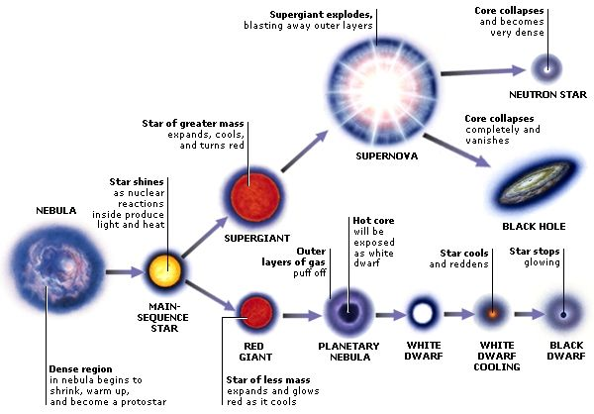

Slide 3
The Moon
I will be able to understand the moon phases and eclipses.

Slide 4
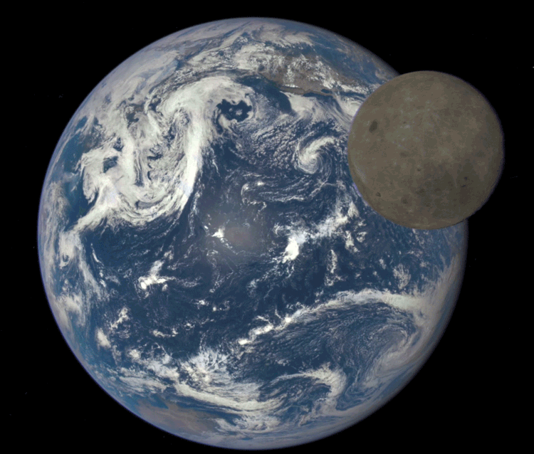
The moon is earth’s satellite.
The moon takes about 28 days to revolve around the Earth.
We never see the other side of the moon (the dark side of the moon).

Slide 5
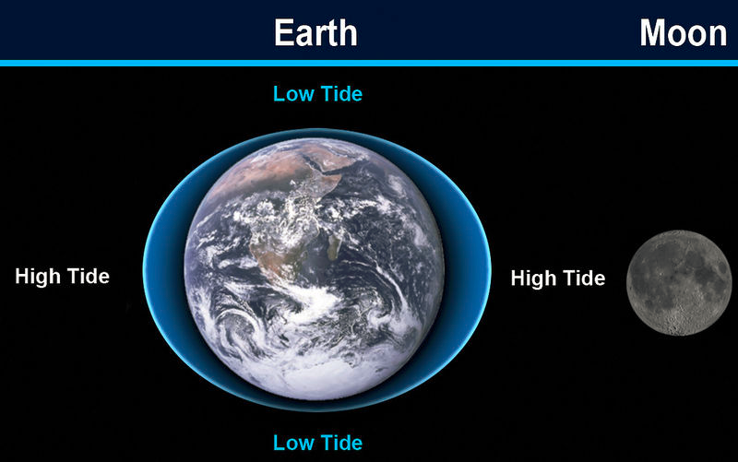
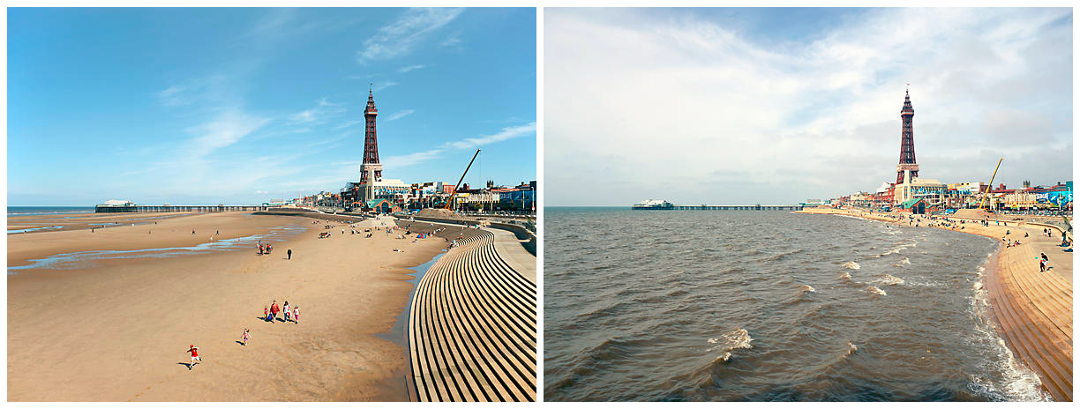
Tides
Tides are the rise and fall of sea levels caused by the combined effects of gravitational forces exerted by the Moon, Sun, and rotation of the Earth.

Slide 6
Moon Phases!

Slide 7
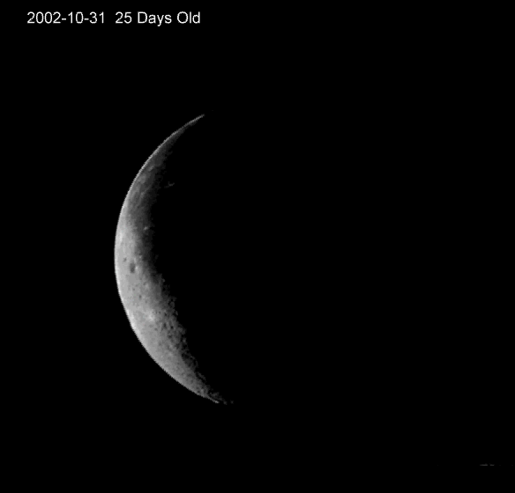
When the moon seems to get bigger it is waxing and when it is getting smaller it is waning.

Slide 8
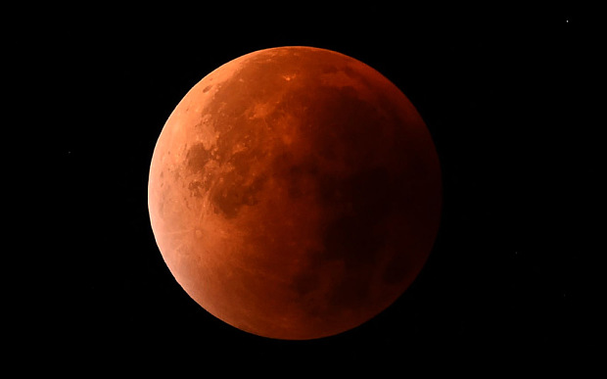
Lunar Eclipses
the moon appears darkened as it passes into the earth's shadow

Slide 9
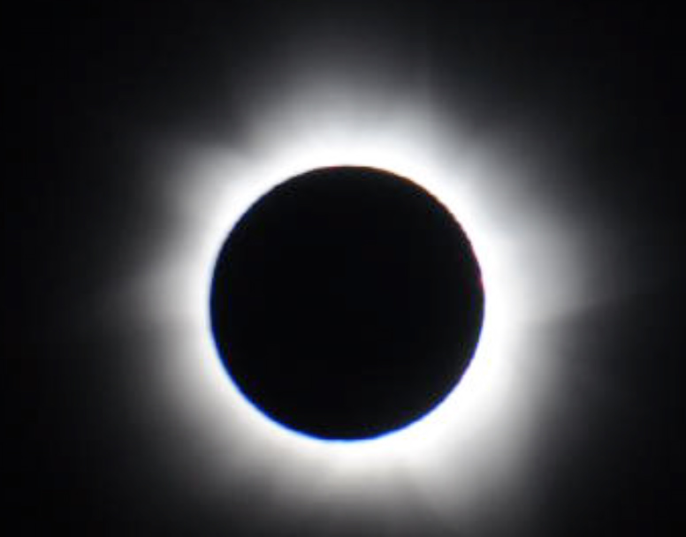
Solar Eclipse
the sun is hidden by the moon.

Slide 10
Seasons are caused by earth Tilt!

Slide 11
http://www.sciencechannel.com/video-topics/space-videos/space-school-moon/

