Slide 1
I will be able to identify different rock types and how they are formed.

Slide 2

Essential Question:
What are Rocks?
Rocks …
Solid earth material
Make up the crust of the Earth
Mixture of one or more minerals
Range in size from giant mountains to grains of sand
Can be smooth or rough, shiny or dull, one color or many colors
More about Rocks from Discovery
Notes:
Engage and Explore: distribute a collections of rocks to each group First click on the hyperlink What are Rocks ( print selection) for a discussion. Click on Rocks are for more info. If you have Discovery click on link.
Have students define a rock and name the three main types. Use the Grade 4 AIMS Earth Book, booklet Rock Types for reading, note-taking and discussion.
Explore: Pass out samples of rocks that are from the 3 types for students to observe. AIMS gr. 4 Earth Science has several lessons on identifying rocks. Students could choose a rock one per student in a group to observe, measure and identify its type and record in their journals. Students can place the rocks in a group and have members read their descriptions and see who can identify the designated rock. Two rocks can be compared using a VENN diagram. Rocks can be classified by size, luster, hardness, volume, etc.
Explain: Each of the three types are hyperlinked and you can click on them to learn more. The next slides also provide more information on each type.

Slide 3
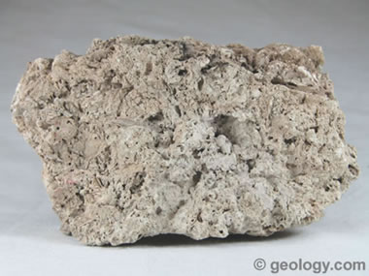
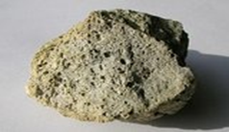
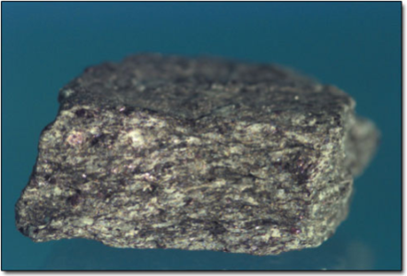
What are the Three main types of rocks?
Sedimentary Rock
Igneous Rock
3. Metamorphic Rock
Rock Type Photographs and more: http://geology.com/rocks/
Notes:
Engage/Explore/Explain: Ask the essential question and listen to responses. Then click on Three main types to watch a free BrainPop link . Have students name them and list them in their notebook. If you have Discovery click on the rock types:
1. Sedimentary Rock
2. Igneous Rock
3. Metamorphic Rock

Slide 4
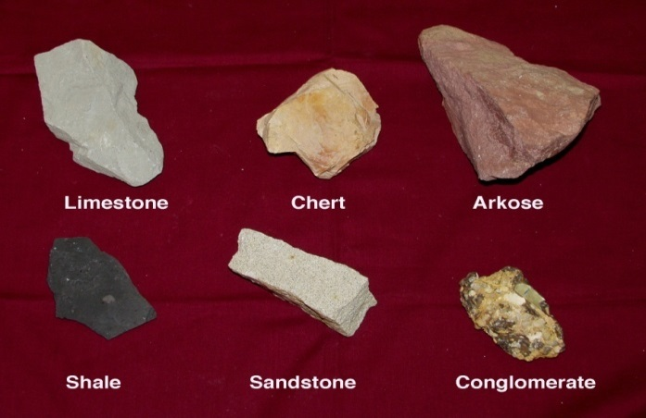
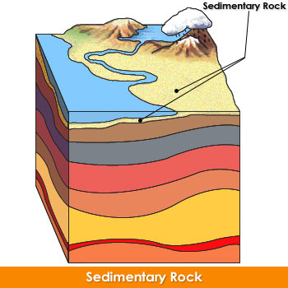
Sedimentary Rocks
Form when layers of rock particles get pressed together at or near Earth's surface https://www.pearsonsuccessnet.com/snpapp/login/login.jsp
Nickname = “Layered” rocks
May contain fossils
Common near bodies of water or where water existed in the past
Characteristics: Layers Loosely compacted
Distinct particles Dull Light Colored
Light weight
See http://geology.com/rocks/sedimentary-rocks.shtml for photographs and more.
Notes:
Explore and Explain: Open hyperlink: Sedimentary Rocks and read, explore and discuss. Have sample of sedimentary (limestone – schoolyard /home backyard) rocks. I
Students take notes on main characteristics.
Extend: Gr. 4 AIMS activity: Settling on Sediments
Log in to https://www.pearsonsuccessnet.com/snpapp/login/login.jsp
Gr. 5 Take in to the Net. Go to Games and click on Earth Science Unit, chapter 9 Active Art for Sedimentary Rock Formation animation. If not registered, click on the register button.
Enter the access code SFSCAL07FLEN05T and your school’s zip code.
ASK: What type of rocks do we find in Miami and South Florida? (sedimentary - limestone) How do you know? ( some answers: limestone rocks contain fossils of ocean life from when south Florida was covered by water. Limestone is mined here for making of cement.)
Evaluate: What do we call the breaking down of rock that creates sediment? That’s right- weathering.
Let’s look at some types of physical weathering. Go to the next slide.

Slide 5
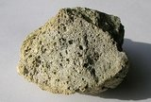
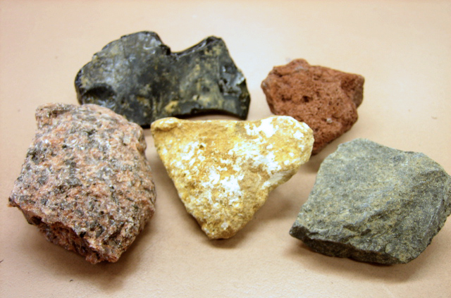
Igneous Rocks
Form when magma (hot liquid rock) cools and hardens
Cools very fast = glassy with holes
Cools fast = glassy
Cools slow = small crystals
Cools very slow = large crystals
Nickname= “Fire formed” rocks:
Pumice is a gas-charged igneous rock.
Can you identify some others?
http://geology.com/rocks/metamorphic-rocks.shtml
2
3
1
5
4
granite scoria obsidian pumice
Notes:
Explore and Explain: Open the two hyperlinks to learn more about igneous rocks. Students identify their main properties or characteristics and take notes.
You can look at specific types through the site and/or actual rocks if available.
Evaluate: Ask them to identify granite (#1) obsidian (#2) and scoria ( #3) from the picture.
See http://geology.com/rocks/metamorphic-rocks.shtml for photographs and more.

Slide 6
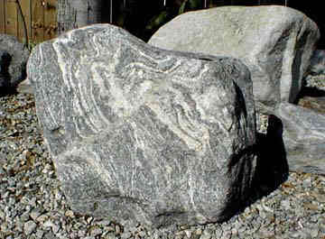

Metamorphic Rocks
Form when underground rocks are changed due to high pressure
Nickname = “Changed” rocks
Common in mountains
Characteristics:
Thick layers Blended colors
Tightly compacted Blurred particles Shiny
Rock Type Photographs and more: http://geology.com/rocks/
See http://geology.com/rocks/metamorphic-rocks.shtml for photographs and more.
Notes:
Explore and Explain: Open hyperlink: Metamorphic Rocks and read, explore and discuss. Have sample of metamorphic rocks if available.
Students take notes on main characteristics.
Extend: Gr. 4 AIMS activity: Metamorphic Munchies.

Slide 7
What’s the Rock: Reference Sheet
1. Igneous: Form when magma cools and hardens.
Cools very fast = glassy with holes
Cools fast = glassy
Cools slow = small crystals
Cools very slow = large crystals
2. Sedimentary:Form when layers of rock particles
get pressed together
Loosely compacted layers Distinct particles Dull Light Colored
3. Metamorphic:Form when underground rocks are
changed due to high pressure
Thick layers Tightly compacted Shiny
Blended colors Blurred particles
(Adapted from Utah Elem. CORE Academy 2006)
Notes:
Rock Identification Reference Sheet

Slide 8
