Slide 1
Plant Life Cycle, Reproduction, and Structures
SUPPLEMENTAL RESOURCES
SCIENCE FUSION LEVELED READERS:
Plants and How They Grow (Blue)
The Life of an Oak Tree (Green)
  Roots p.4-5
  Xylem/Phloem p.6-9
  Leaves p. 10-12
SCIENCE FUSION E-TEXTS 3RD/4TH GRADE:
3rd grade text: Unit 6- Plants and the Environment
4th grade text: Unit 9- Life Cycles and Growth
BRAIN POP:
Reproduction: Plant Growth: https://www.brainpop.com/science/cellularlifeandgenetics/plantgrowth/
Seed Plants: https://www.brainpop.com/science/diversityoflife/seedplants/
Seedless Plants: https://www.brainpop.com/science/diversityoflife/seedlessplants/
Pollination: https://www.brainpop.com/science/cellularlifeandgenetics/pollination/
STUDY JAMS:
Reproduction: plants with seeds: http://studyjams.scholastic.com/studyjams/jams/science/plants/plant-with-seeds.htm
Reproduction: plants without seeds: http://studyjams.scholastic.com/studyjams/jams/science/plants/plants-without-seeds.htm

Slide 2
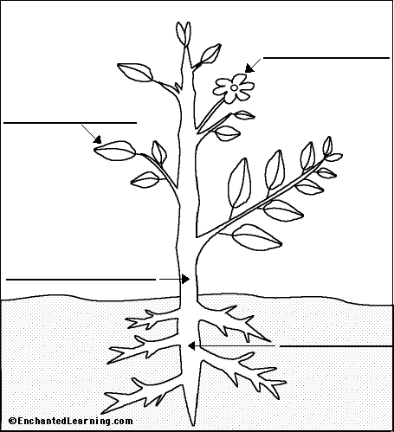
Plants Parts
The Life Cycle of Flowering Plants (Plant Structures and Functions)
Word Bank: roots stem leaf flower
Notes:
Explore/Explain
Students illustrate a plant and label parts with functions.

Slide 3
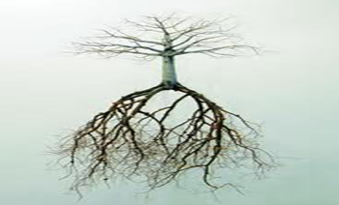
What is the role of roots?
Roots are plant structures that hold a plant in place and take in water and nutrients from the soil.
Department of Mathematics and Science
Notes:
Explain

Slide 4
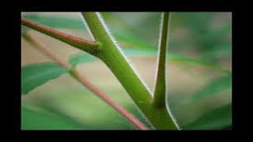
What is the role of the stem?
The stem is the part of the plant that holds the leaves up to sunlight and moves water, nutrients and food through the plant.
Department of Mathematics and Science
Notes:
Explain

Slide 5
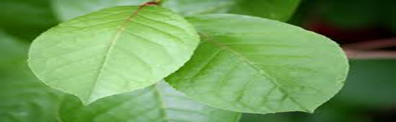
What is the role of leaves?
The leaf is the plant organ where photosynthesis take place to make food for the plant.
Department of Mathematics and Science
Notes:
Explain

Slide 6
Purpose of a Flower
Are Flowers
More Than
Just Pretty?
Department of Mathematics and Science
Notes:
Engage: Read aloud Flowers: More Than Just Pretty . Discuss what we can do to find out the answer.

Slide 7
Flower Power
Essential Question: What are the parts of a flower and the function of each part?
Learning Goals:
Observe and identify flower parts.
Recognize the function of a flower,
identifying the processes of reproduction
including pollination, fertilization, seed
dispersal, and germination.
Department of Mathematics and Science
Notes:
Engage.

Slide 8
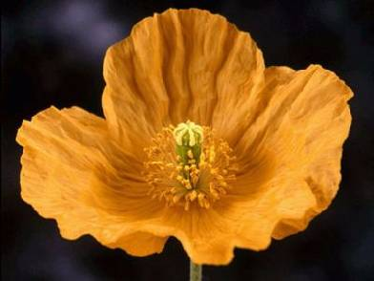
The Parts of a Flower
What are the three main parts of
flowers?
  petals
  stamens
  pistil
Notes:
Explain: Gr. 4 SF pp. 54-55 Parts of a Flower View Love Me, Love me not to see parts of the flower.

Slide 9
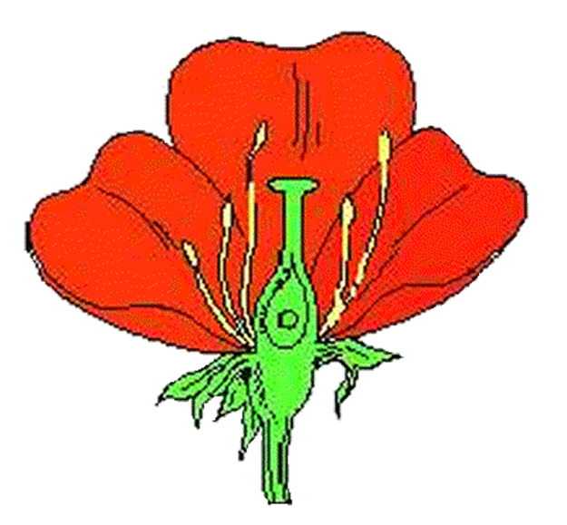
The Stamen:
Male Reproductive Part of a Flower
Anther:
pollen grains (sperm cells) grow in the anther.
Filament:
holds the anther
Department of Mathematics and Science
Notes:
Explain

Slide 10
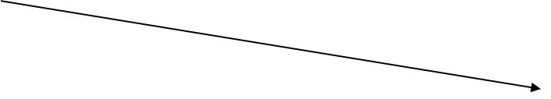
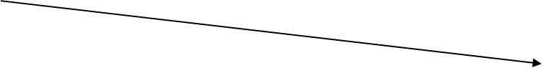
The Pistil:
Female Reproductive
Parts of a Flower
Stigma
Style
Ovary (carpel)
Eggs(ovules)
Department of Mathematics and Science
Notes:
Explain

Slide 11
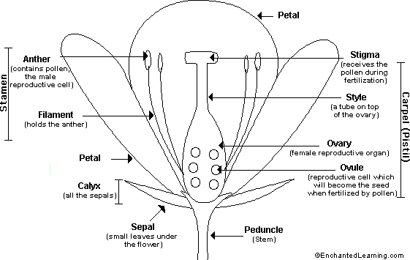
The Parts of a Flower
Sepals protect the bud until it opens.
Petals attract insects.
Stamens make pollen.
Pistil contain the ovary which contains the ovules (eggs).
When fertilized, ovules grow into fruits which contain seed.
2.
3.
4.
5.
1.
Department of Mathematics and Science
Notes:
Explain

Slide 12
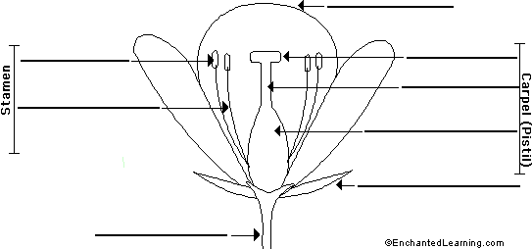
Parts of a Flower
Quiz
3. _____
3.
______ has two parts:
a. anther
b. filament
5a..
4a..
4b.
4. ______has
three parts:
a. Stigma
b. Style
c. Ovary
5.b
4c.
2. _____
1
2.
Word Bank: petal pistil sepal stamen stem
Notes:
Evaluate: Quiz - Number paper 1. – 5. Use word bank to identify the numbered parts. Then have students complete Connected Learning ?’s 1-8.

Slide 13
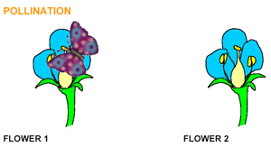
What is Pollination?
Gizmos: Flower Pollination
Pollination is the act of transferring pollen grains from the male anther of the stamen to the female stigma.
Pollen lands on a female pistil, sperm cells move down to the ovary, fertilizing the egg cells.
Fertilization combines DNA.
  The result is a seed with a tiny plant inside.
  The ovary grows into a fruit to protect the seeds.
Notes:
Explain: Gr. 4 SF pp. 56-57 Pollen on the Move

Slide 14
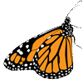

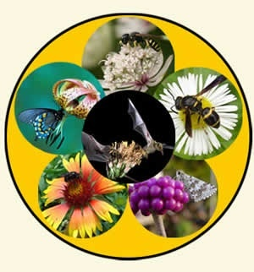
Pollinators
Animals, wind, and water can all help in the transfer of pollen.
We call animals or insects that transfer pollen from plant to plant "pollinators ".
The flower type, shape, color, odor, nectar, and structure vary by the type of pollinator that visits them.
Notes:
Explain

Slide 15
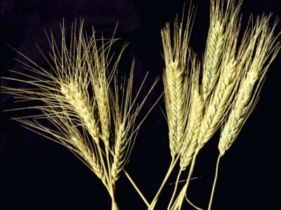
Wind Pollination
  Some flowers, such as grasses, do not have brightly colored petals and nectar to attract insects.
These flowers are pollinated by the wind.
Notes:
Explain

Slide 16
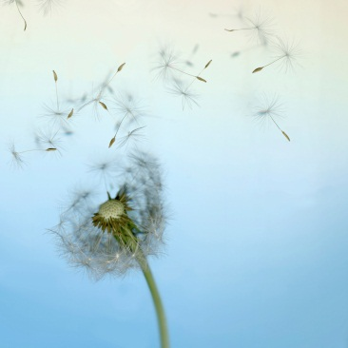
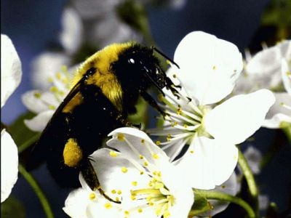
Flowering plants use:
  the wind
  insects
  bats
  birds
  mammals
to transfer pollen from the stamen (male) part of the flower to the stigma (female) part of the flower.
Department of Mathematics and Science
Notes:
View video to see View of Attraction for pollinators.

Slide 17
Check Point
What is pollination?
How do flowering plants depend on other living things in order to reproduce?
Why are young plants like but not identical to their parents?
Notes:
Explain for review: Students make the foldable – Plant Reproduction.

Slide 18
Gone to Seed
Three main parts:
1. seed coat - a covering with two roles:
- Protects new plant called embyro
- Guards stored food called endosperm.
2. endosperm – stored food
3. embryo – The new plant with structures called seed leaves or cotyledons.
Notes:
Explain: Gr. 4 SF p. 58 parts of a seed and view Gone to seed to see what happens after pollination.

Slide 19
Observing Seeds
Senses & Hand Lens
Sight - Looks
Touch - Feels
Hearing – Sounds when dropped
Odor – Smells
Qualitative
Observations
Measurement Tools
Ruler
Tape measure
Balance
Gram mass pieces
Quantitative
Observations
Department of Mathematics and Science

Slide 20
Observing a Seed
Observe the outside of a dry bean seed with a hand lens. Draw it and write down four or more properties including length and width.
Get a wet bean seed to observe. Draw it and write down four or more properties including length and width.
Why is the wet seed larger?
Split it open and observe its parts. Draw and label its inside including the seed coat, cotyledon, and embryo.
Department of Mathematics and Science
Notes:
Explore

Slide 21
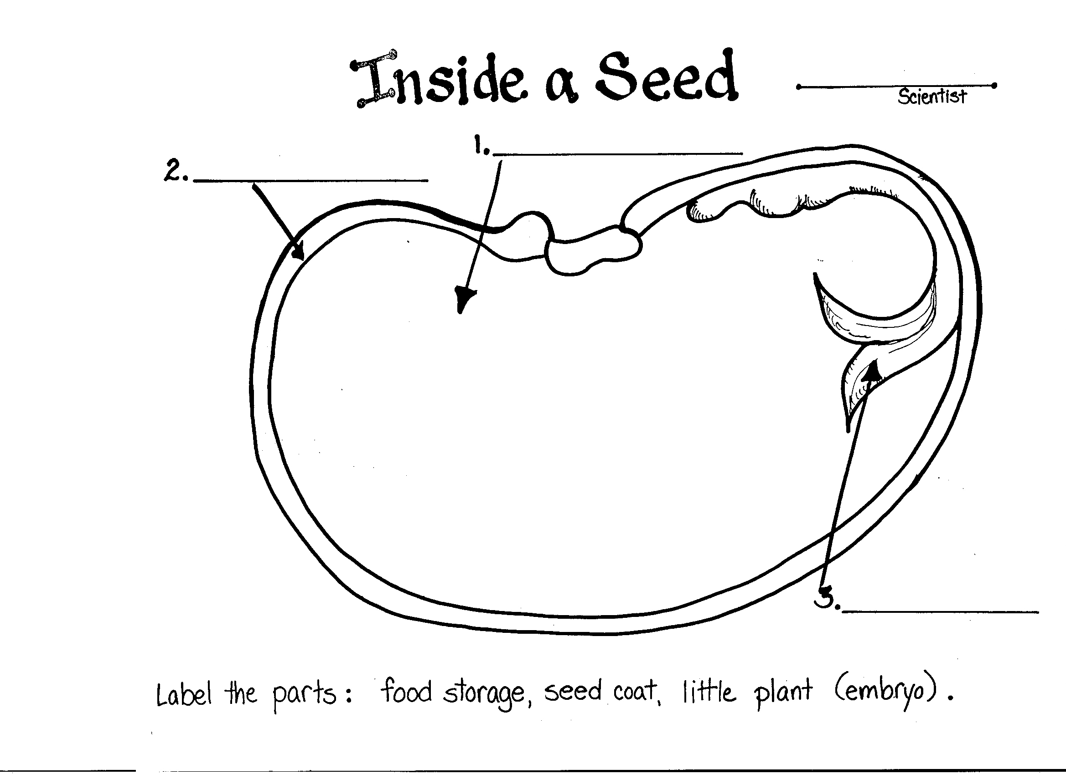
Wet Bean
2nd Let’s explore …
1st Lets make Dry Seed
Observations:
Length:
Width:
Mass:
Color:
Texture:
3rd
Cotyledon or
Notes:
Explore/Explain: Have students explore the variables that affect seed germination by going online to www.explorelearning.com and doing the Germination Gizmo.

Slide 22
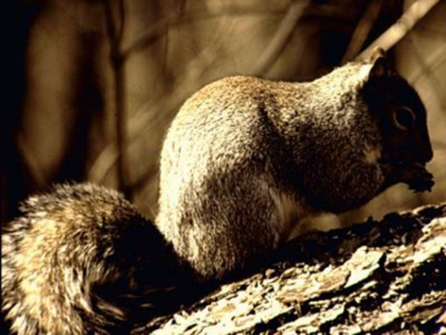
How do seeds get dispersed from a plant into the ground?
Some seeds are hidden in the ground by animals such as squirrels as a winter store.
Some seeds have hooks on them and cling to fur or clothes.
Notes:
Explain

Slide 23
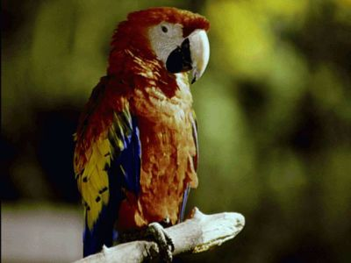
How do birds and animals help seed dispersal?
Birds and animals eat the fruits and excrete the seeds away from the parent plant.
Notes:
Explain

Slide 24
What are ways Seeds are Carried Away from a Plant?
Animal-carried
Animal-consumed
Water-borne
Wind-borne
Propelled
Department of Mathematics and Science
Notes:
Explore: Take students on a seed scavenger hunt around the schoolyard.

Slide 25
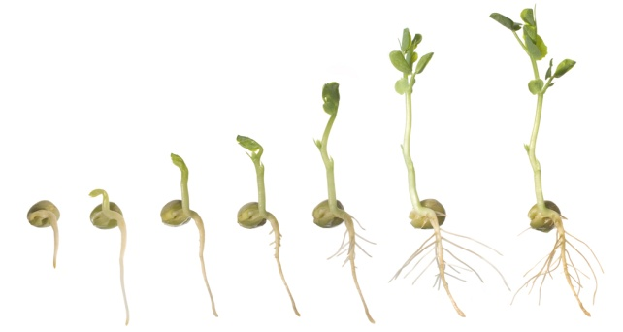
Seed Germination
What do seeds need to sprout?
Water
Oxygen
Proper temperature
Some require proper light
Notes:
Explain/ Evaluate:

Slide 26
Seed Germination
What are the variables that affect germination?
Water
Proper temperature
Some require proper light
Oxygen
Test your ideas on the Gizmo: Germination.
www.explorelearning.com
Department of Mathematics and Science
Notes:
Explain/Explore: Click on Germination to learn more about variables that affect germination.
Students can also do the GIZMO: Germination.

Slide 27
Parts of a Vascular Plant
Resource: Leveled Reader: The Life of an Oak Tree (Green)
  Roots p.4-5
  Xylem/Phloem p.6-9
  Leaves p. 10-12

Slide 28
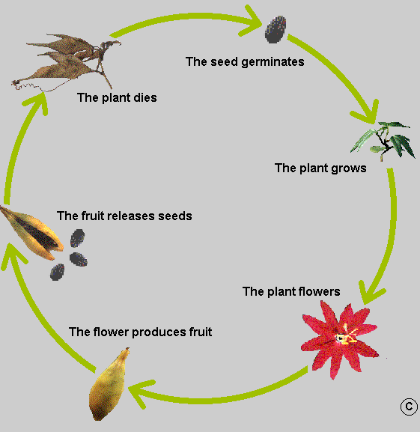
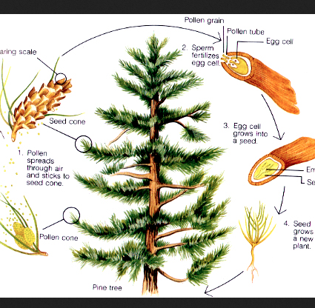
Comparing Plant Life Cycles
Some plants produce flowers
Other plants produce cones
Notes:
Engage: Ask students to explain what they have learned about how flowering plants reproduce. Then have them watch the three video clips
Explore/Explain: Then have them look at the illustration of a pine tree a nonflowering plant. What is the difference between these two plants. How are they similar?

Slide 29
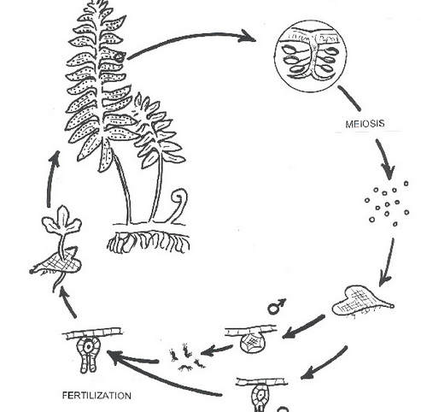
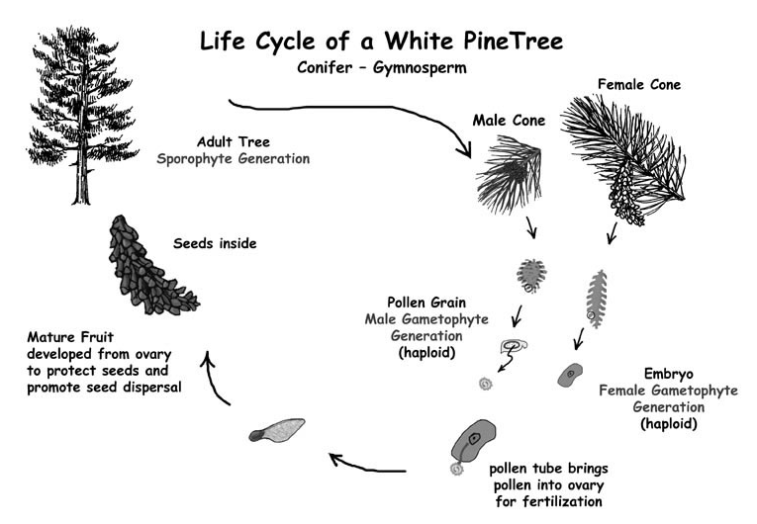
Comparing Nonflowering Plants
Moss and ferns produce spores.
Conifers such as a Pine tree produce cones
Notes:
Explain

