Slide 1
Big Idea 17: Interdependence:
Needs of Organisms
SUPPLEMENTAL RESOURCES
BRAIN POP:
https://www.brainpop.com/science/ecologyandbehavior/foodchains/
SCIENCE FUSION LEVELED READER:
The Flow of Energy (Blue)
SCIENCE FUSION E-TEXT:
3RD Grade: Unit 8 Living Things Change
4th Grade: Unit 10 Organisms and Their Environment
\

Slide 2
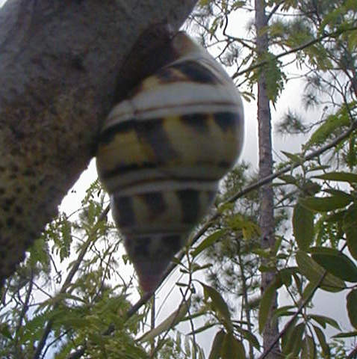
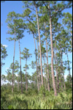
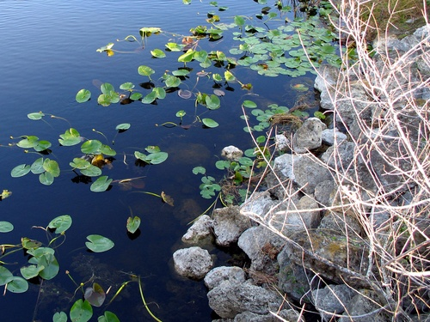
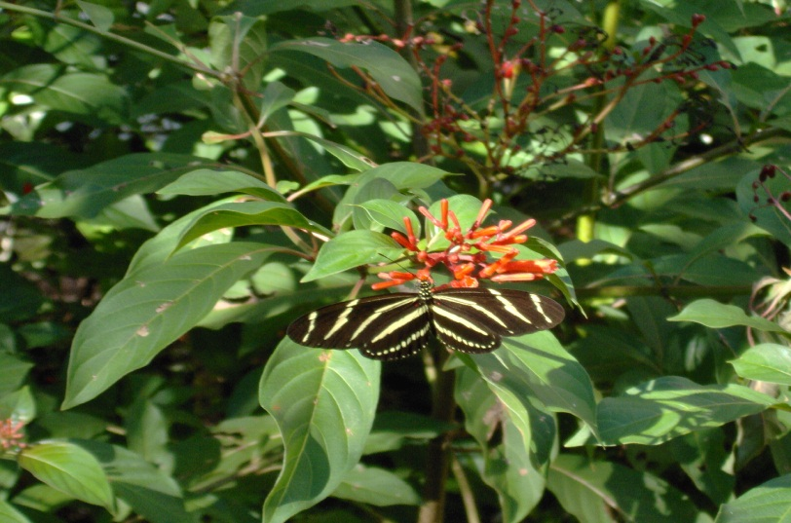
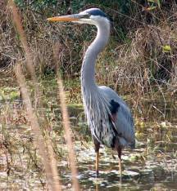
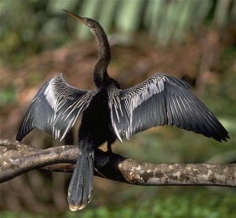
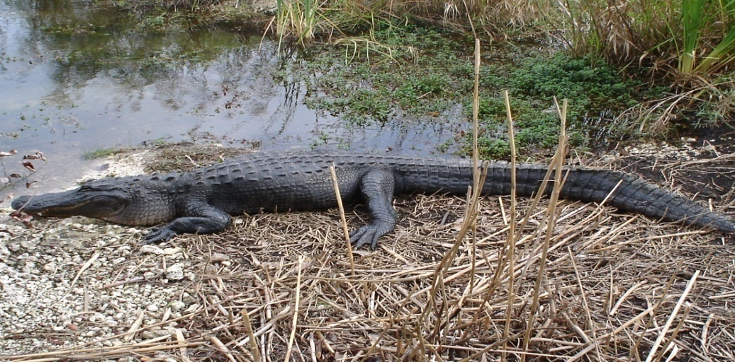
What do all organisms need to survive?
Florida Everglades
Organisms need a source of energy to survive.
The sun, plants, and animals are all sources of energy for organisms.
Notes:
Engage and say: Imagine you are walking outdoors in a woody area, maybe in the Everglades National Park. Click on the hyperlink for a one min. video clip. What could you see? Here or there you may see …animals- alligators, birds (anhiga, blue heron,) tree snails, butterflies (zebra), plants (water lilies, pine trees, firebush, sawgrass), water
(fresh water slough)
Each of these living things are connected to each other in the life of the Everglades ecosystems.
Ask: What do all living things need in order to live, grow, and reproduce.
Yes, all organisms need energy in order to live, grow, and reproduce. In ecosystems, energy is passed from one organism to another.
Ask what do we call the path by which energy moves from one living thing to another? Food chains
Energy moves to all organisms by food chains.
Food chains can help us to understand how animals depend on plants and sometimes on other animals. In other words all living things depend on each other or are interdependent.

Slide 3
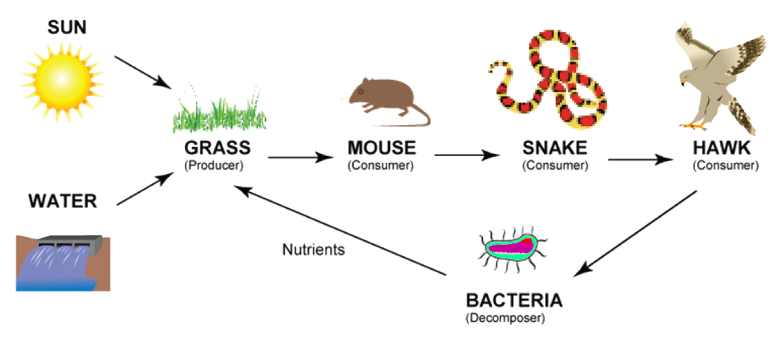
How is energy passed from one living thing to another?
A food chain is the path by which energy
passes from one living thing to another.
How do plants get their energy?
Notes:
Explore and Explain: Have students read The Critter Connection Food Chain foldable booklet p. 5 to learn about food chains.
Then click on the hyperlink : food chain to view More Food Chains video and discuss.
Evaluate: Then ask:
Where did the grass get its energy from?
Where did the snake get its energy from?

Slide 4
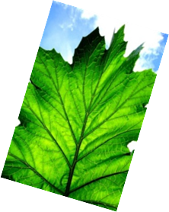
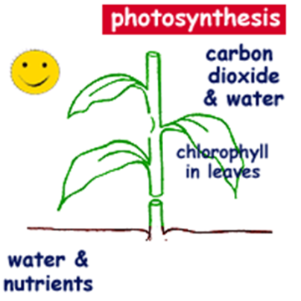
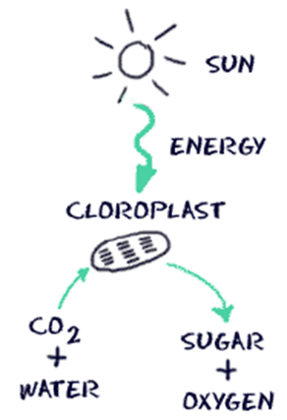
How do plants get their food?
Plants make their own food in their leaves using four ingredients:
1. carbon dioxide (CO20)
2. water (H20)
3. chlorophyll from the leaves
4. light from the sun
The chlorophyll in the leaves captures the sunlight’s energy and along with the water and carbon dioxide plants produce a food called sugar
and release oxygen.
Why would a plant die without leaves?
Notes:
Explain/Evaluate for one more review: Ask the question, How do plants get their food?. Then read and discuss the AIMS booklet , Leaves Make Food with students. Have students name the main points. You can ask the additional following questions: What are the ingredients? What happens in the process?
Next have them go to the last page of the Leaves Make Food booklet and ask the question: Why would a plant die without leaves? Students can respond in the booklet.
Have students share responses. Then ask why would animals not survive without plants? Students can respond in the booklet. Let students share a few responses. Tell students we will look at this more closely in the next few days.

Slide 5
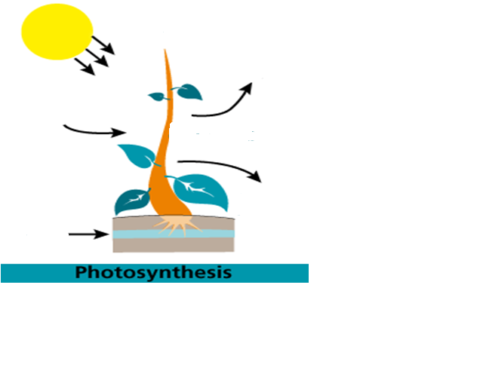
Draw an illustration with captions to explain how plants make their own food through Photosynthesis.
Vocabulary to include: carbon dioxide (CO₂) chlorophyll leaves oxygen sunlight sugar water (H₂O)
Notes:
Click on the hyperlink: Photosynthesis to see an animation of interdependence at work . Click on launch interactive and the open The Cycle.
Evaluation: You can have students follow the slide directions to draw an illustration or have them do the Photosynthesis Recipe Card activity that is presented on the next two slides.

Slide 6
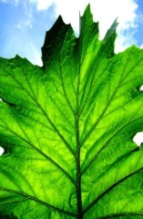
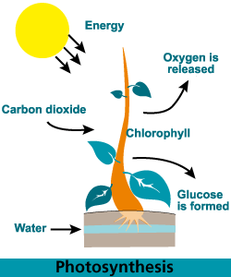
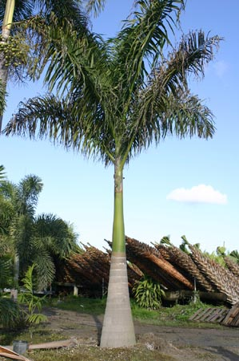
Why are plants called Producers?
Plants make their own food through the process of Photosynthesis.
What 4 ingredients do plants use to make their own food?
What do plants produce?
What do plants release?
3. Sunlight
6.
2.
4.
5.
1.
Notes:
Explore and Explain: Say let’s take a closer look at how plants make or produce their own food. (Click on the hyperlink: Who are the Producers? to watch a video.) Say let’s watch the video to find out who are the producers and what ingredients plants use to make their own food.
FYI Here’s an explanation of photosynthesis: Leaves, another organ found in plants are the main food making parts. They make food through the process of photosynthesis. Carbon dioxide from the air is taken in through tiny holes called *stomata on the underside surface of the leaves, and the roots take in the water from the soil that is transported to the leaves xylem vessels in both the stem and leaves. The carbon dioxide and the water are combined using energy taken in from sunlight by the chloroplasts that contain chlorophyll, a green chemical that absorbs the Sun’s light energy. This process produces chemicals, the plant’s food called glucose and also oxygen.
After the video: Ask the following:
Who are the producers?
What is the process called when plants make their own food?
What are the 4 ingredients ?
You can also do Bagging Photosynthesis inquiry activity as a small group or whole class demonstration. See the activity sheet.

Slide 7
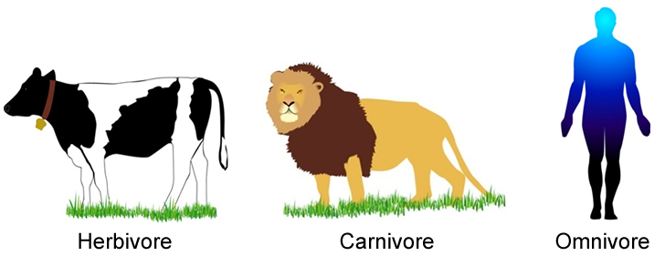
Who are the Consumers?
Consumers cannot make their own food.
They eat other organisms to get energy.
There are three types of consumers: herbivores, carnivores, and omnivores.
Notes:
Explore: Click on the hyperlink: Who are the Consumers? to play a video that reviews producers and adds consumers.
Explain: Have students read The Critter Connection Food Chain foldable booklet p. 3 to find out what animals who cannot use energy from the sun to make their own food are called.
Ask:
How do they get their energy?
How many types of consumers are there?

Slide 8
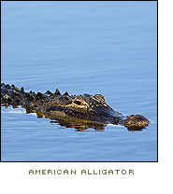

Consumers
Herbivores eat plants. The prefix “herbi-” means green grass plants. Rabbits and deer are examples of herbivores.
Carnivores eat meat. The prefix “carni-” comes from the Spanish word “carne,” which means meat. Alligators, wolves, cougars, and sharks are examples of carnivores.
Omnivores eat both plants and animals.
The prefix “omni-” means “all.” People, raccoons and bears that eat meat, fish, and vegetables are examples of omnivores.
Notes:
Explore: Click on the hyperlink: Consumers to learn about them.
Explain
Ask:
What do herbivores eat?
What do carnivores eat?
What do omnivores eat?

Slide 9
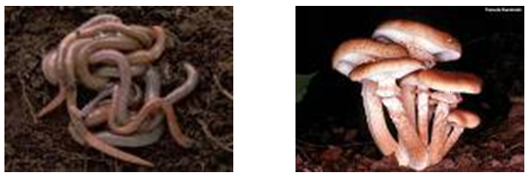
Who are the Decomposers?
They are organisms that feed on waste and remains of dead organisms.
Decomposers get energy by breaking down the remains of producers and consumers into nutrients.
Earthworms, bacteria, and fungi (such as mushrooms) are examples of decomposers.
Notes:
Explore: Click on the hyperlink: Who are the Decomposers? To learn about them.
Explain: Have students read The Critter Connection Food Chain foldable booklet p. 4 to learn about decomposers.
Ask:
Who are decomposers?
What are some examples?
How are decomposers and consumers alike?
How are they different?

Slide 10
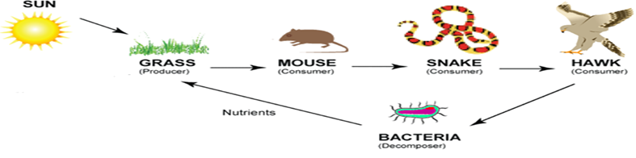
Food chains can help us to understand how animals depend on plants and sometimes on other animals.
What would happen to the hawk population if there were no snakes?
What would happen to the mouse population if there were no snakes?
All together producers, consumers, and decomposers form an interdependence.
Notes:
Explore: Click on the hyperlink Food chains to explore some animated samples of food chains for simulation and discussion.
Explain and Evaluate:
Next ask:
What would happen to the hawk population if there were no snakes?
What would happen to the mouse population if there were no snakes?

Slide 11
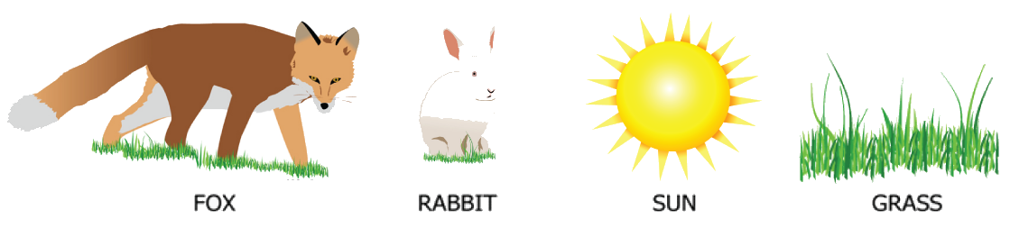
Using all of the pictures and/or names below, draw and label a possible food chain
How are plants and animals interdependent?
Notes:
Explain/Evaluation:
Have students answer the question: How are plants and animals interdependent?
Then click on the hyperlink - play the video and discuss.
Extend: This can be class work or Homelearning:
Students complete the last page on The Critter Connection Food Chains p. 8 activity.

Slide 12
Food Chain Assessment
Read the following scenario and complete A & B
Huckleberry bushes grow in sunny patches in the forest. Birds eat the berries. Coyotes eat the berries, too. Sometimes coyotes also eat the birds.
Identify each living thing in this food chain as a
consumer, or producer.
For the living things you identified as consumers in
part A, identify whether they are herbivores, carnivores, or omnivores. Explain how you made your choices.
Notes:
Additional assessment

Slide 13
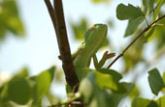
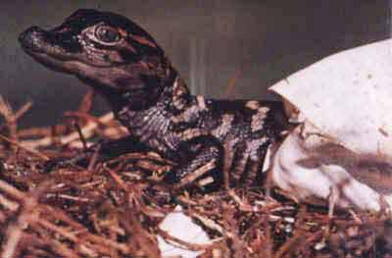

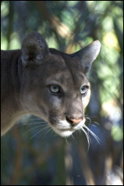
What is interdependence?
The way all living things depend on each other.
No plant or animal lives alone.
Each depends in some way upon other plants and/or animals for energy in order to live, grow, and reproduce.
Notes:
Explain: Ask students to explain what interdependence is. Students can break down the word interdependence and use the pictures from the slides and the Everglades film segment. Then pass out The Critter Connection Food Chain foldable booklet. Have students read p. 2 to find out what gives living things energy. Where does all energy originally come from? Why are plants called producers?

Slide 14

Concept Review:
Parts of a Food Chain
1. What sources of energy do all organisms need?
Answer: Organisms need a source of energy to
survive. The sun, plants, and animals are all
sources of energy for organisms.
Which organisms are producers and which are
consumers in a food chain?
Answer: Plants are producers that make their
own food for energy. Herbivores, carnivores,
and omnivores are consumers that eat
other organisms as food.

Slide 15

3. How do plants get energy?
Answer: Plants get energy from the food they make. Plants use sunlight, water, and air to make food to live and grow. Some plants are carnivorous and also get energy by eating other organisms.

Slide 16

4. How do animals get energy? How is this different for herbivores, carnivores, and omnivores?
Answer: Animals get energy from other organisms. Herbivores get energy by eating plants. Carnivores get energy by eating other animals. Omnivores get energy by eating both plants and animals

Slide 17
FCAT Review
1. The Sun is the original source of energy for most living things. Which organisms on Earth can convert this solar energy directly into food?
Humans
Animals
Insects
plants

Slide 18
FCAT Review
2. The cheetah is the fastest land animal on Earth. Able to reach speeds of up to 65 miles per hour, the cheetah uses its speed to catch its prey, mostly mammals. The cheetah's prey is the best source of which of the following?
Oxygen
Water
carbon dioxide
energy

Slide 19
FCAT Review
Plants make up most of the Earth's biomass, or organic material. What would happen to consumers if there were no more plants?
They would use photosynthesis to make their own food.
They would die because they would have no source of energy.
They would get their energy from other sources, like oxygen.
They would eventually adapt to only eating other consumers.

