Slide 1
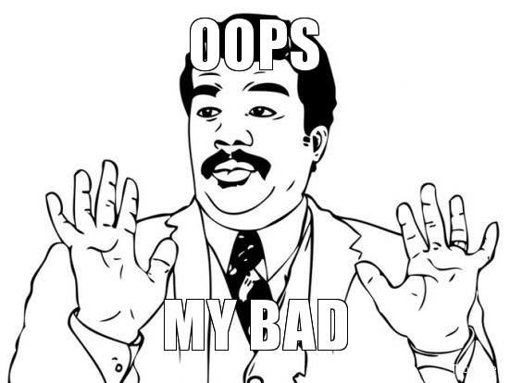

Slide 2
25%
33. Point A was placed at 0.549 on the number line below.
What is this number rounded to the nearest tenth?
A. 0.50
B. 0.54
C. 0.55
D. 0.60

Slide 3
40%
30. Look at the number below.129,796
Which answer contains an 9 that is worth 10 times the value of the number 8 above? A. 194,531 B. 156,923 C. 145,690 D. 130,709

Slide 4
50%
14. Which expression shows the product of an unknown number and one hundred? A. n ÷ 100 B. n + 100
C. n × 100
D. n – 100

Slide 5
60%
11. What is the place value of the underlined digit?14.0576 A. tenths B. hundredths C. thousandths D. ten-thousandths

Slide 6
65%
27. Round 369.864 to the nearest hundredth. A. 300 B. 0.06 C. 369.86 D. 369.85

