Slide 1
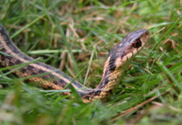
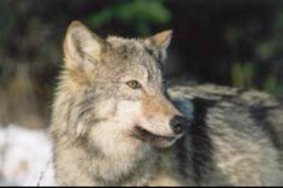
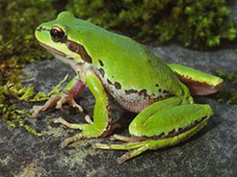
Classification of Animals SC.3.L.15.1
SUPPLEMENTAL RESOURCES
BRAIN POP:
Classification: https://www.brainpop.com/science/diversityoflife/classification/
Science Fusion Leveled Reader:
Classification (Blue)
Science Fusion e-text:
3rd Grade Unit 7 Classifying Living Things
Notes:
Open Discovery Education on your employee portal so that your can play the Discovery Education hyperlinks as they appear in the slides. The hyperlinks are underlined: example - Classifying Animals

Slide 2
What are the two main groups that scientists classify all animals into?
Vertebrates
Backbone
Skeletons inside their bodies, help them stand and move around
Examples:
giraffe, people,
Dog, shark, bird, fish
Invertebrates
No backbone
Some have:
Skeletons onside their body
Grow shells
No hard parts in or outside of their body
Examples:
beetle, snail, worm
Notes:
Explore/Explain

Slide 3
More on Vertebrates
How can vertebrates can be classified into groups?
By…
skin covering
how they reproduce
how they maintain body temperature
characteristics of their limbs (arms and legs, or their equivalent such as wings or fins)..
Notes:
Explore/Explain have students answer the ? In their notebooks and then share responses.

Slide 4
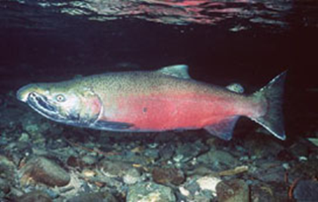
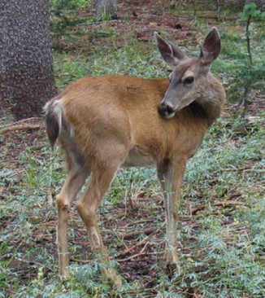
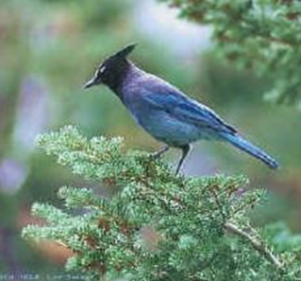
What are the 5 Groups of Vertebrates?
Fish
Amphibians
Reptiles
Mammals
Birds
Notes:
Explain/Evaluate: First click on link to review the 5 Groups of Vertebrates. Then have students name them in their notebook and draw and name several examples.

Slide 5
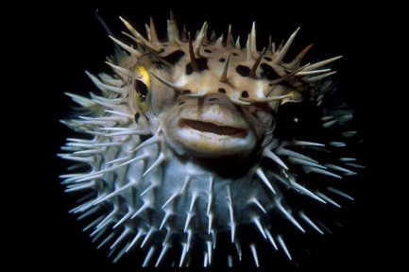
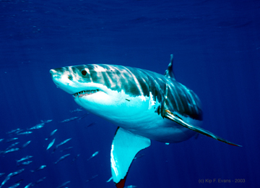
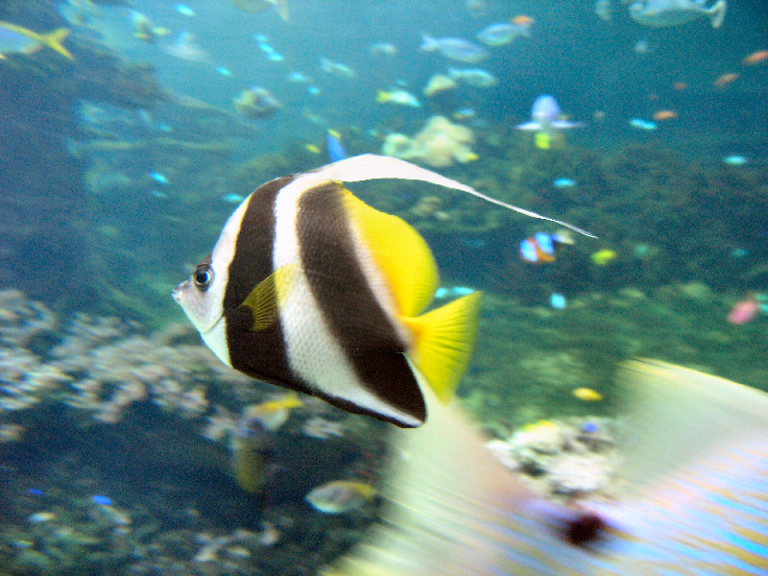
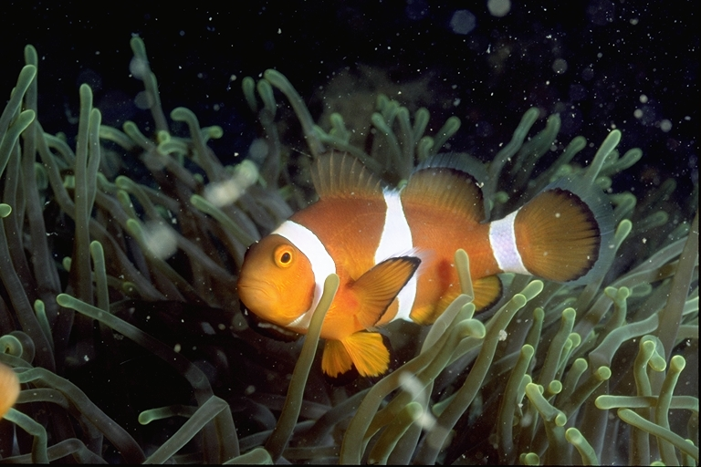
Fish
Lives in water
Have wet scales
Breathe with gills
Some lay eggs in water
Notes:
Explore/Explain: Ask students what they know about fish. Then tell students we will watch a video on fish to see what else we can learn about fish Have students share characteristics that all fish have in common.

Slide 6
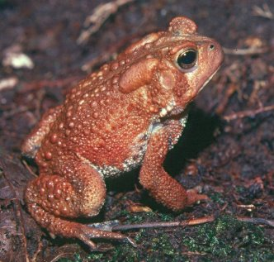
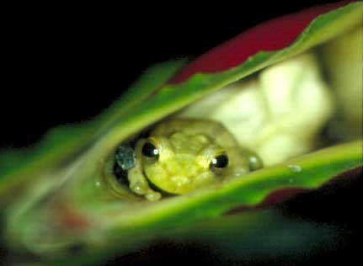
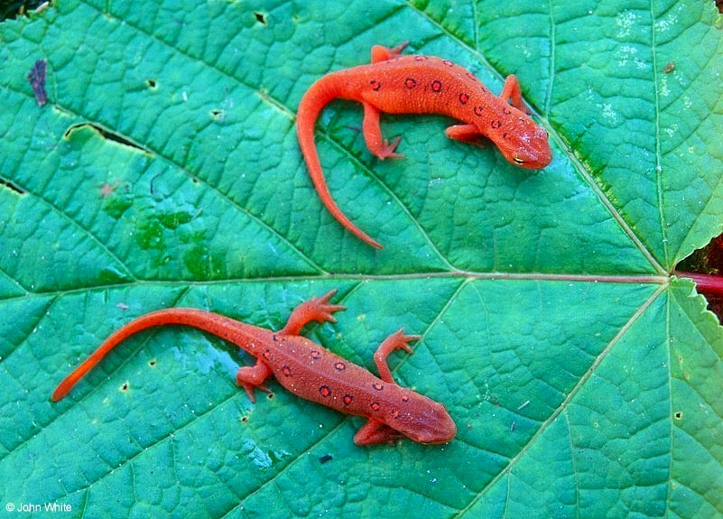
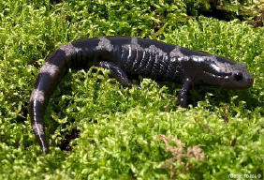
Amphibians
Lives on land and water
Have moist skin
Lay jelly coated eggs in water
Notes:
Explore/Explain: Ask students what they know about amphibians . Then tell students we will watch a video on amphibians to see what else we can learn about amphibians. Have students share characteristics that all have in common.

Slide 7
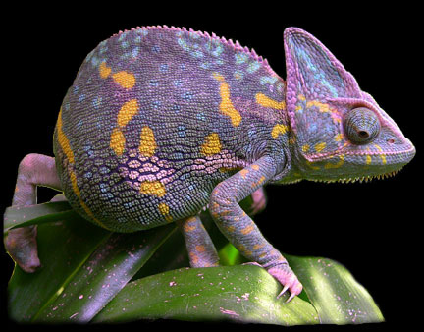
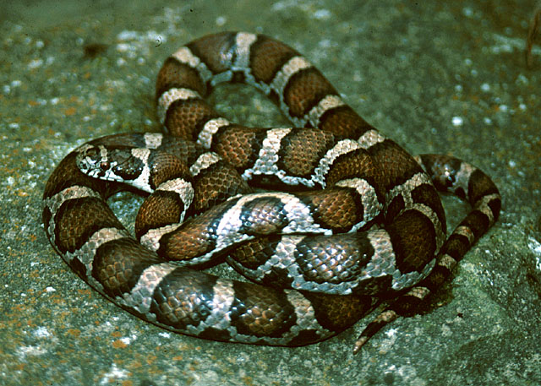
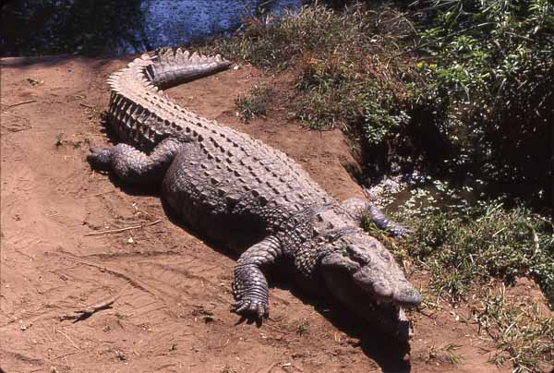
Reptiles
Have dry scales
Lay leathery shelled eggs
Cold blooded
Notes:
Explore/Explain: Ask students what they know about reptiles. Then tell students we will watch a video on reptiles to see what else we can learn about reptiles. Have students share characteristics that all have in common.

Slide 8
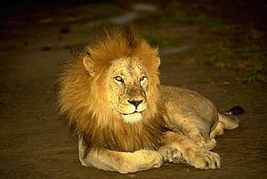
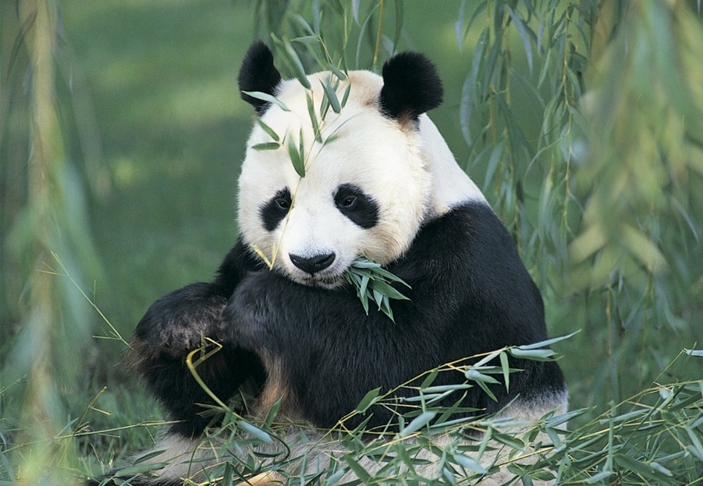
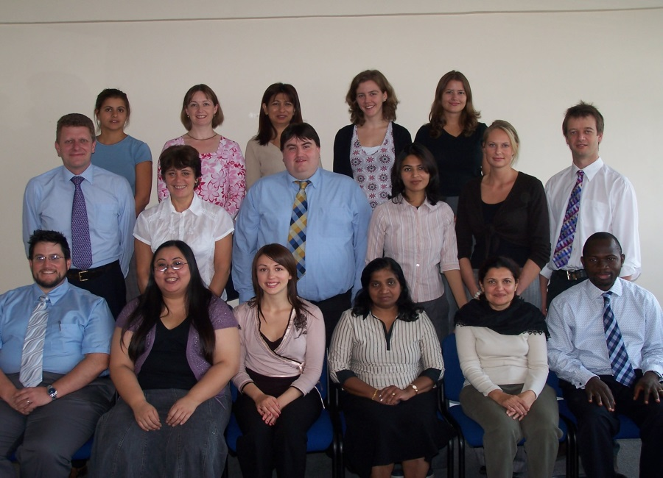
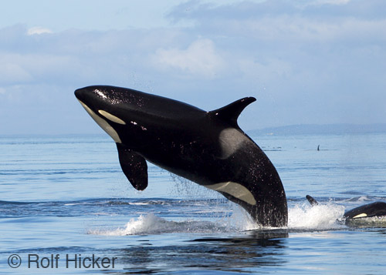
Mammals
Have hair and produce milk
Give birth to live offspring (no eggs)
Warm blooded
Notes:
Explore/Explain: Ask students what they know about mammals . Then tell students we will watch a video on mammals to see what else we can learn about mammals. Have students share characteristics that all have in common.

Slide 9
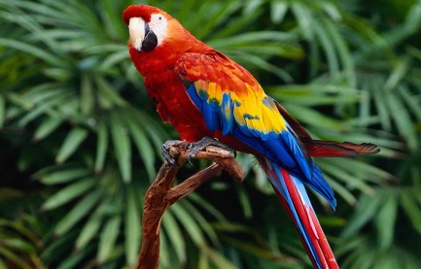
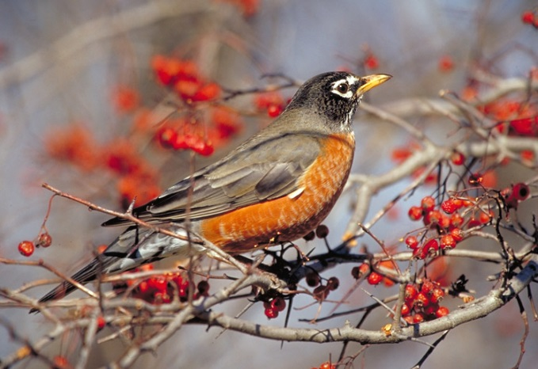
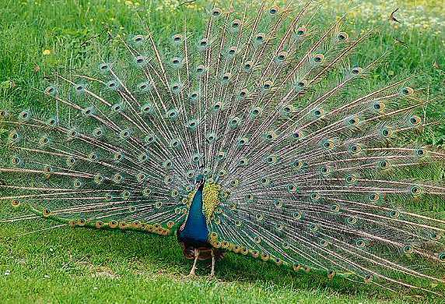
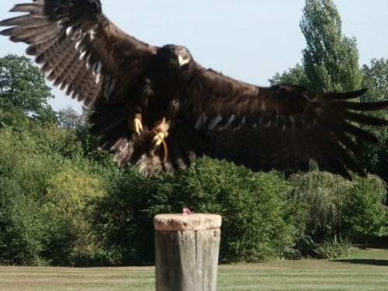
The World of Birds
Bird Characteristics
Have feathers
Are warm blooded
Have hollow bones
Lay hard shelled eggs
Quiz
Visit www.birdsleuth.org
Notes:
Explore/Explain: Ask students what they know about birds. Then tell students we will watch a video on birds.( click on the link, The World of Birds), The World of birds to see what else we can learn about birds. Then watch the Bird Facts video for additional facts. Have students share characteristics that all birds have in common.
Extend: Visit Website: www.birdsleuth.org fpr resources developed by educators at the Cornell Lab developed BirdSleuth with support from the National Science Foundation to help educators bring the power and engagement of citizen science and inquiry to students.
.

Slide 10
Summary of Vertebrates
Notes:
Explain

Slide 11
CHARACTERISTICS OF THE FIVE TYPES OF VERTEBRATES
 | How It Breathes | Body Covering | Born Alive or Lays Eggs | Warm or Cold Blooded | Another Distinctive Feature
Amphibians
Birds
Fish
Mammals
Reptiles
Notes:
Explain/Evaluate

Slide 12
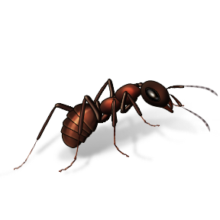
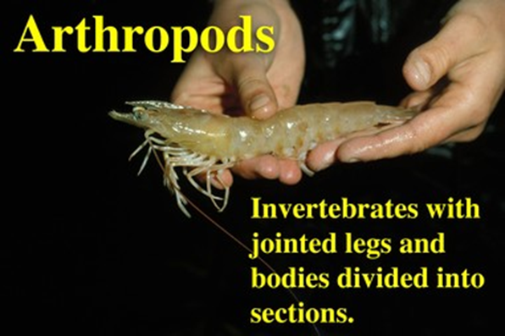
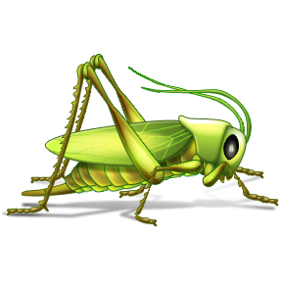
More on Invertebrates
Arthropods are the largest group of invertebrates
What do they all share in common?
Jointed legs or limbs
Hard body covering that forms an outer skeleton
Examples include centipedes, millipedes, spiders, mites, horseshoe crabs, scorpions, crustaceans (lobsters) and insects
Notes:
Explore/Evaluate
Students will only be tested on invertebrates with an exoskeleton the arthropod group.

Slide 13
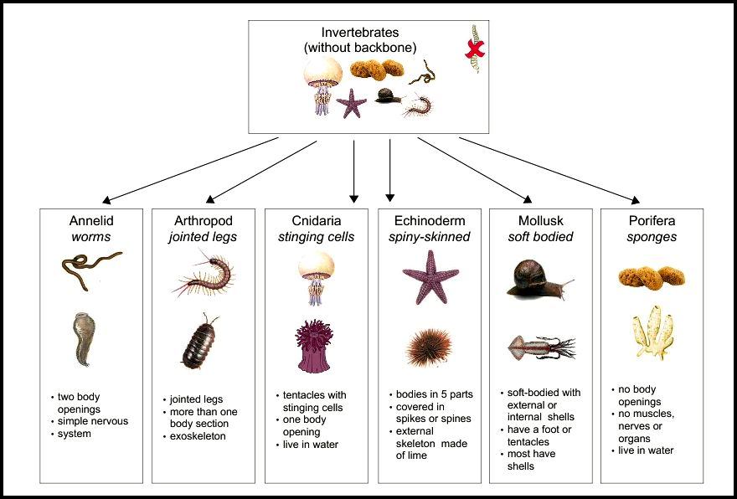

Slide 14
Why are animals grouped into different categories?
Answer: They are grouped into different categories because they use different types of physical features to carry out the activities they need to live.
For example, birds are grouped together because they have wings, feathers, and beaks, while fish are grouped together because they have fins, scales, and mouths.
Bonus: Why are arthropods grouped together?
Notes:
Explain/Evaluate

Slide 16
Linnaeus's system has seven levels:
Kingdom
Phylum
Class
Order
Family
Genus
Species

